Slide 1
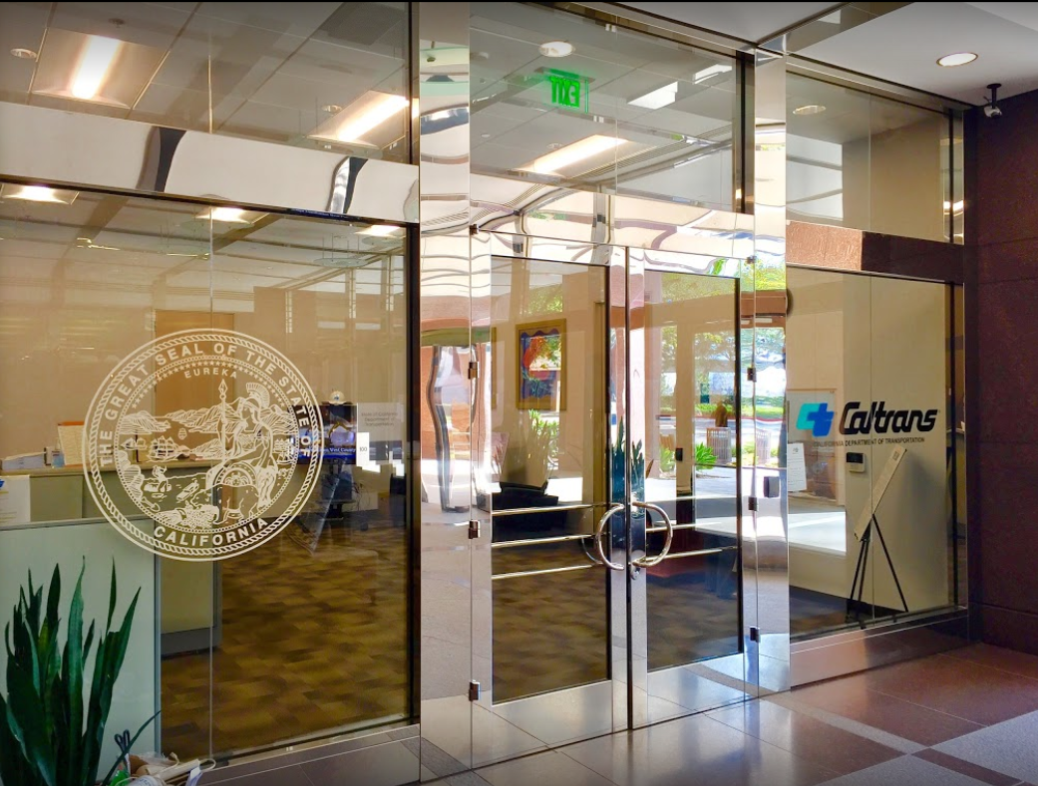
TECHNICAL ADVISORY COMMITTEE MEETING
LOCAL ASSISTANCE UPDATE
Jonathan Lawhead Kathleen Nguyen
D12 Local Assistance Branch Chief (DLAE) D12 Local Assistance Program Manager
Caltrans District 12 Caltrans District 12
Jonathan.Lawhead@dot.ca.gov Kathleen.Nguyen@dot.ca.gov
(424) 413-1124 (805) 732-9777
October 23, 2024

Slide 2
TECHNICAL ADVISORY COMMITTEE MEETING
LOCAL ASSISTANCE UPDATE
TABLE OF CONTENTS
PAGE | UPDATE ITEM
1 FFY 24/25
2 Inactive Invoices
3 CTC Meetings
4 ATP
5 Highway Bridge Program
6 Clean California
7 DBE/QAP
8 PED Extensions
9 Title VI
10 References and Training Opportunities
11 Staff Assignments/Contacts

Slide 3
Federal Fiscal Year 24/25
New Federal Fiscal Year Reminders, please ensure:
DBE Annual Submittal forms (LAPM Exhibit 9-B and 9-C) have been submitted for FFY 24/25.
QAP has been updated in the past 5 years if a project will be receiving federal CON funds this year.
Most recent version of LAPM Exhibits are being used when submitting documentation.
2025 FTIP adoption to occur in December 2024.
1

Slide 4
Inactive Invoices
Deadline to submit inactive invoices for next quarter is November 22, 2024.
New inactive quarter will begin on January 1, 2025.
Reminder letters will be sent out after the new quarter begins.
Inactivity may prevent E-76s from being processed.
The official inactive list can be viewed here:
https://dot.ca.gov/programs/local-assistance/projects/inactive-projects
If you have questions or issues with submitting invoices, please contact your assigned Local Assistance Area Engineer for further assistance.
2
Notes:
We have had several cases statewide and even in the district where E-76s were rejected last FFY because there were ongoing inactives.

Slide 5
CTC Meetings
The 2025 CTC Meeting Schedule has been posted on the CTC Meeting Webpage.
The 2025 CTC Meeting Preparation Schedule has also been posted.
Next CTC Meetings:
October 17-18, 2024 – Bakersfield.
December 5-6, 2024 – Riverside.
Deadlines to submit allocations and time extensions to District 12 Local Assistance:
December 2, 2024 for the January 2025 CTC Meeting.
3

Slide 6
Active Transportation Program (ATP)
November 1st - Staff recommendation for Statewide Small Urban & Rural components, and Quick-Build Pilot Program will be posted.
Active Transportation Resource Center (ATRC) is planning a training presentation on NI/Plan projects, which will be announced through the ATRC Newsletter.
The recording and resources for the recent ATP CalSMART Reporting Webinar are available on the Caltrans ATP – ATP Project Reporting webpage.
Caltrans’ ATP webpage: https://dot.ca.gov/programs/local-assistance/fed-and-state-programs/active-transportation-program
4
Notes:
Completion Report is due to Caltrans within six months of construction contract acceptance or the project becoming operable (open to the public), whichever comes sooner.
Final Delivery Report is due within 180 days of the conclusion of all remaining project activities beyond the acceptance of the construction contract.
All reports are due to the CalSMART online reporting tool and can only be submitted during an open reporting period.

Slide 7
Highway Bridge Program (HBP)
EPSP and Post-Programming closed for HBP projects until April 1, 2025.
Information may be subject to change. For more info and guidance, please see Caltrans’ HSIP webpage: https://dot.ca.gov/programs/local-assistance/fed-and-state-programs/highway-safety-improvement-program.
5

Slide 8
Clean California Local Grant Program (CCLGP)
Cycle 1 delivery deadline was June 30, 2024, without an extension.
Cycle 2 delivery deadline is June 30, 2026.
Please see the Clean CA webpage for more info and application guidelines: https://cleancalifornia.dot.ca.gov/local-grants/local-grant-program.
6

Slide 9
DBE/QAP
Several Caltrans Disparity Study Results presentations will be held throughout November. Registration link for these presentations have been sent out via email and can be found via the link below:
https://bit.ly/3MuyZSX
QAP forms and annual DBE Forms need to be up to date and on file with Caltrans D12 Local Assistance in order to process E-76s and receive federal funding.
Quality Assurance Program (QAP) forms need to be updated and approved every 5 years.
If you have questions or issues with submitting DBE/QAP forms, please contact your assigned Local Assistance Area Engineer for further assistance.
7

Slide 10
PED Extension
New way to request extensions for Project End Dates (PED).
Entirely online and replaces old E-76 system.
Link: https://app.smartsheet.com/b/form/dd8ec43edae54b8aad35159cacec011a
Work done after a PED cannot be reimbursed!
More info and a report listing upcoming PED expirations can be found here: https://dot.ca.gov/programs/local-assistance/projects/projects-with-expiring-end-dates
8

Slide 11
Title VI
Title VI of the Civil Rights Act of 1964 prohibits discrimination by recipient of Federal assistance on the basis of race, color, and national origin, including the denial of meaningful access for limited English proficient (LEP) Persons.
Requirements include but are not limited to:
Title VI nondiscrimination statement
Assurances (as part of the Master Agreement and Program Supplement Agreement.
Designation of a Title VI Coordinator.
Complaint Procedures.
Data Collection.
Training.
Dissemination of Information.
Contracts and Agreements.
Environmental Justice.
Public Hearings and Meetings.
Right of Way activities.
Construction contract compliance.
Monitoring.
Caltrans has also recently updated our webpage on Filing a Complaint, and it provides guidance to local agencies on how to process Title VI complaints.
9

Slide 12
References and Training Opportunities
California LTAP training:
https://caltap.org/training.aspx
Local Assistance Blog:
https://www.localassistanceblog.com/local-assistance-training/
Local Assistance Procedures Manual (LAPM)
https://dot.ca.gov/programs/local-assistance/guidelines-and-procedures/local-assistance-procedures-manual-lapm
Local Assistance Program Guidelines (LAPG)
https://dot.ca.gov/programs/local-assistance/guidelines-and-procedures/local-assistance-program-guidelines-lapg
10

Slide 13
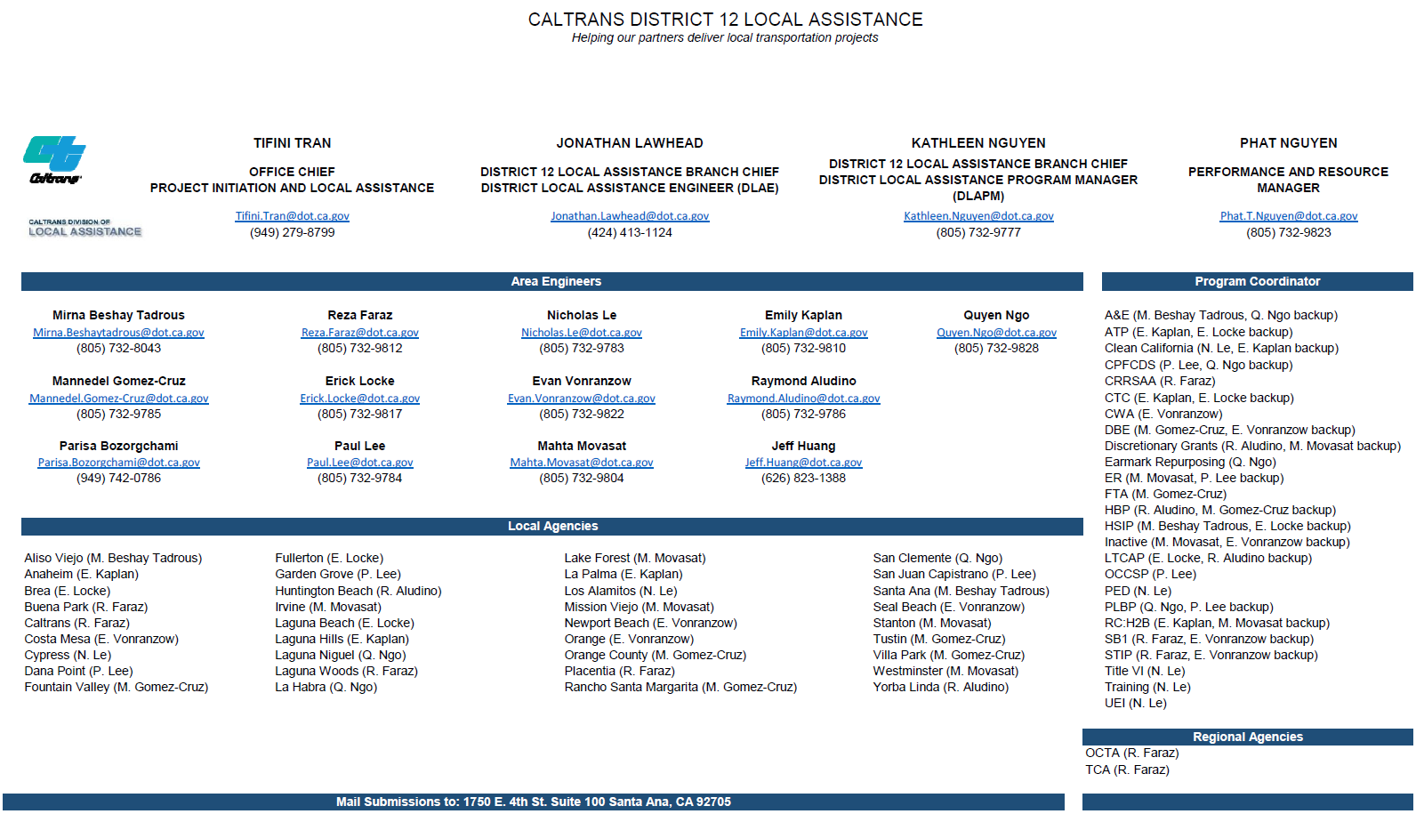
11

