Slide 1
FY2021 Enhanced Mobility for Seniors and Disabled Grant Program
The Meeting Will Begin Shortly

Slide 2
Welcome!

Slide 3
GUIDELINES
Participant video and microphone functions will be disabled
Questions can be submitted by clicking the Q&A button and typing in questions
Participants can also make spoken comments by raising their hand (* 9 on phones) – unmute yourself once it’s your turn to speak (* 6 on phones)
Notes:
Presentation will be recorded for our note taking purposes
This presentation will be available on our website on 4/29
www.octa.net/emsd

Slide 4
Presentation

Slide 5
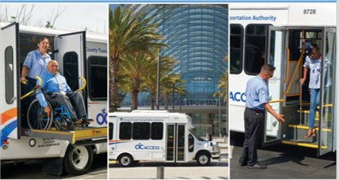
OVERVIEW
Background
Goals
Prior Call
Coordinated Plan
Fiscal Year 2021 Call Overview
Draft Guidelines
Schedule
Feedback
Notes:
Thank you Cristina. Good afternoon everyone - my name is Jennifer Farinas and I am the Program Manager for the EMSD grant program. Today I will be providing an overview on the Call for Projects (or Call for short) – program background, goals, prior call, coordinated plan, fiscal year 2021 Call overview, draft guidelines, and schedule.
Next slide please.

Slide 6
PROGRAM BACKGROUND
OCTA’s Enhanced Mobility for Seniors and Disabled (EMSD) grant program is:
Based on Federal Transit Administration Section 5310 grant program - 49 U.S.C. 5310
Guided by the Coordinated Plan
Approved by the OCTA Board of Directors on November 23, 2020
Notes:
OCTA’s Enhanced Mobility for Seniors and Disabled (or EMSD) Grant Program is based on the Federal Transit Administration (or FTA) Section 5310 Grant Program and corresponding circular.
The EMSD program is guided by the recommendations of OCTA’s Coordinated Public Transit – Human Services Transportation Plan (or Coordinated Plan for short), which was recently updated in November 2020. The EMSD grant program incorporates recommendations from the Coordinated Plan.
Next slide please.

Slide 7
PROGRAM GOALS
EMSD grant program is designed to:
Offer grants based on Coordinated Plan to meet transportation needs of seniors and disabled
Provide local funds in lieu of federal funds
Reduce the risk of non-compliance for OCTA and grantees
Notes:
The Call offers grant opportunities to non-profit organizations and local public agencies to help meet the special transportation needs of seniors and the disabled in Orange County. The Call provides local funding in lieu of FTA funding to relieve applicants of stringent federal requirements and reduce the risk of non-compliance for both OCTA and its grantees.
Next slide please.

Slide 8
Prior Call
Covered October 2018 – September 2020
Awarded $1.252 million to 6 agencies
Eligible projects:
Replacement and expansion vehicles and supporting equipment
Limited operations, mobility management, driver and travel training
Provided 12 vehicles, supported 2 agency operations, provided mobility management and computer software
Notes:
The Prior Call was in effect October 2018 through September 2020 and awarded $1.252 million to 6 agencies. The types of projects that were eligible included replacement and expansion vehicles and supporting equipment, operations, mobility management, and driver and travel training. The Prior call awarded grants to purchase 12 vehicles, supported 2 agency operations, and awarded assistance for mobility management and computer software.
Next slide please

Slide 9
Coordinated Plan
Recommended goals:
Restore and Enhance the Specialized Public Transportation in a Post-COVID-19 Environment
Re-build Specialized Services for Target Populations
Leverage Transportation Information to Enhance Mobility-Measure Outcomes
Improve and Expand External and Internal Mobility Infrastructure
Available at www.octa.net/emsd
Notes:
The Coordinated Plan’s overall recommended goals and strategies included restoration and enhancement of the specialized public transportation network to meet the needs of target populations in a Post-COVID-19 environment, rebuild specialized services for target populations, leverage transportation information to enhance mobility-measure outcomes, and improve and expand external and internal mobility infrastructure.
A copy of the plan is available on the EMSD webpage at www.octa.net/emsd under the resources tab.
Next slide please.

Slide 10
FY2021 CALL OVERVIEW
The upcoming call will include:
$4 million for FY2022 to FY2023
Special focus
Improved coordination
Agency outreach
Similar project types – capital and operating
Vehicle and related equipment replacements
Expansion Vehicles
Limited operations - mobility management, driver and travel training projects, COVID-19 response equipment
Looking at first and last mile options
Notes:
For the fiscal year 2021 call, a total of $4 million is available in local funding to administer projects. We would like projects to start January 2022 and be complete by December 2023.
Based on Coordinated Plan recommendations, there will be a special focus on projects which improve coordination and outreach in the application. Projects which demonstrate improved coordination and outreach will score higher.
Next slide please

Slide 11
Eligible applicants
Private, non-profit organizations
“Active” non-profit status
Public agencies where no private non-profits provide the service
Documentation of public hearing required
Notes:
Eligible applicants include non-profit organizations and public agencies where no non-profits provide the proposed service.
Non-profit status must be documented as “active”. This is required as an attachment to the application.
Public agencies should schedule and complete a public hearing prior to the application deadline, which is tentatively scheduled for mid-September. Documentation of the public hearing will be required as an attachment to the application.
Next slide please

Slide 12
Project Types & Evaluation
Capital and Operating projects will be scored differently
Capital Projects
Increased vehicle revenue hours (>10 hours)
Partnerships that increase efficiency
Increased percentage of wheelchair/lift users
Operating Projects
Restoration of service for up to 6 months
Evaluation Criteria available at www.octa.net/emsd
Notes:
The capital and operating applications will be scored differently. Both applications will have a maximum score of 100 points.
Bonus points are available under the capital category for projects that increase vehicle revenue hours beyond the 10-hour minimum, utilize partnerships to create efficiencies in service, and/or projects that show a greater percentage of wheelchair/lift users as a percentage of total users since those trips generally take longer to accommodate.
Under this call, OCTA will allow restoration of service for up to 6 months to address challenges as a result of the COVID-19 pandemic.
The evaluation criteria are available in the draft guidelines which can be found on the program webpage at www.octa.net/emsd.
Next slide please

Slide 13
ProVISIONS of use
Projects must be included in the Coordinated Plan
Maximum request of $600,000 per applicant
Projects must be ready to proceed
Applicants must have management oversight and control over awarded project
Grantees responsible for proper use, operating costs, and maintenance of all project equipment, and must be prepared to comply with all applicable regulations and requirements
Notes:
All projects must be included in the Coordinated Plan, which is available on the EMSD program webpage under resources. Please refer to page 3 of the draft guidelines.
To ensure equitable distribution of funds, the total maximum request is $600,000 per applicant for the capital and operating categories combined.
All projects must be ready to proceed. Applicants must have management oversight and control over the awarded service and/or purchased equipment.
Grantees are responsible for complying with all applicable regulations and requirements.
Next slide please

Slide 14
POST Award
Reimbursement process is based on awarded project type
Refer to cooperative agreement for specific terms
Quarterly Reporting required
Applicants must notify OCTA of progress and report potential delays
Scope Changes
Applicants must provide justification for the change
Modification requests are not guaranteed
Notes:
If awarded, applicants will be required to enter into a cooperative agreement with OCTA which will spell out all of the terms and conditions, and will very depending on the type of project awarded.
Quarterly reporting will be required and applicants must notify OCTA of any potential delays and extension requests.
Scope changes must be requested via email and provide an explanation and justification for the change. Major changes will require approval by the OCTA Board of Directors. We encourage applicants to complete projects within the original 24-month performance period.
Next slide please.

Slide 15
SCHEDULE
Guideline Workshop​s | April 27 & 28, 2021​
Call Release​ | July 13, 2021​
Application Workshop | July 26, 2021​
Applications Due | September 13, 2021
Award Notification​ | November 22, 2021 ​
Notes:
Finally, the proposed EMSD schedule. We are currently in the proposed guideline workshops phase and are targeting release of the call in the summer with applications due approximately 2 months after the call is released. Based on this timeline, it is anticipated that awarded applicants would be notified in the Fall.
Please note that this schedule is preliminary and subject to change. This concludes my presentation. Are there any questions so far?
Now we will be transitioning to the feedback portion of the presentation. Nora, I will turn it over to you!

Slide 16
2021 EMSD Call
OCTA would like input on the draft EMSD guidelines to better serve Orange County residents.

Slide 17
QUESTIONS AND COMMENTS
Please submit your questions and comments using Zoom Q&A
To speak, please raise your hand in Zoom
Phone users, press * 9 to raise hand
and then * 6 to unmute once called
Notes:
Next slide please.

Slide 18
Funding priorities
Paratransit vehicle replacement and related equipment
New paratransit vehicles and related equipment for expansion projects
Expansion of existing mobility management, and driver and travel training projects
New transportation services, including new mobility management, driver and travel training projects, and first and last mile trips
Notes:
Read all four. Is there anything that you would suggest?

Slide 19
Eligible project categories
Capital - at least 55% (minimum) of funds awarded will be used for ADA accessible vehicle purchases and related support equipment
Operating - the remaining 45% (maximum) may be used for projects that include operating transportation services beyond that required by ADA, as well as:
mobility management
COVID-19 response equipment
driver and travel training
Notes:
Ask about their feedback – anything to add or suggest?

Slide 20
Local Match requirements
A 20% local match is required for vehicles and equipment, mobility management, COVID-19 response equipment, and driver and travel training projects
A 50% local match is required for operating assistance
Notes:
Are these requirements clear? Do you have any other questions or suggestions?
What do you think is fair?
Does anyone have any other questions? Thank you for your feedback.

Slide 21
Draft Guideline Categories
EMSD Goals
Funding Priorities
Fund Availability
Eligible Applicants
Eligible Project Categories
Capital Projects
Operating Projects
Provisions of Use
Evaluation Criteria
Invoicing and Reimbursement
Quarterly Reporting
Scope Changes and Cost Savings
Schedule
Notes:
The slide shows all categories included in the draft guidelines. Are there any questions on categories not covered in the presentation?
Next slide please

Slide 22
CONTACTS
Grant:
Jennifer Farinas jfarinas@octa.net
(714) 560-5392
Louis Zhao lzhao@octa.net
(714) 560-5494
Implementation:
Joanne Jacobsen
jjacobsen@octa.net
(714) 560-5660
Outreach:
Nora Yeretzian
nyeretzian@octa.net
(714) 560-5356
All final comments must be received by Friday, May 14 to be considered.​
Notes:
Here are the contacts for the EMSD Call. Feel free to reach out to us with your feedback and suggestions up until the May 14th deadline.
The tentative release for the call is July 13th, with an application workshop following on July 26th, and final applications are due September 13th.
Next slide please

Slide 23
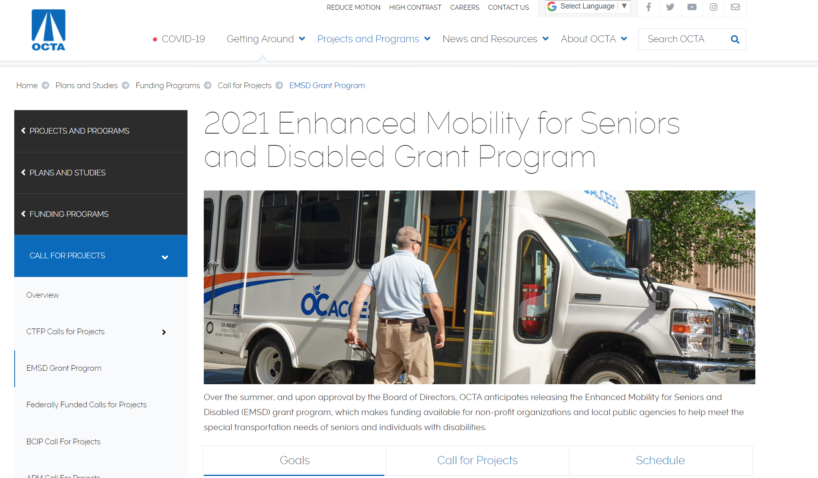
EMSD Program Webpage
Notes:
This is a snapshot taken from the EMSD program webpage at www.octa.net/emsd. Here you can find the overall goals of the program and information for the workshops and survey under the goals tab, draft guidelines and fact sheet under the Call for Projects tab, and tentative schedule under the schedule tab which are shown at the bottom of the picture. Another way to reach this page is to visit www.octa.net and type EMSD in the search bar at the top right of the page.
Next slide please

Slide 24
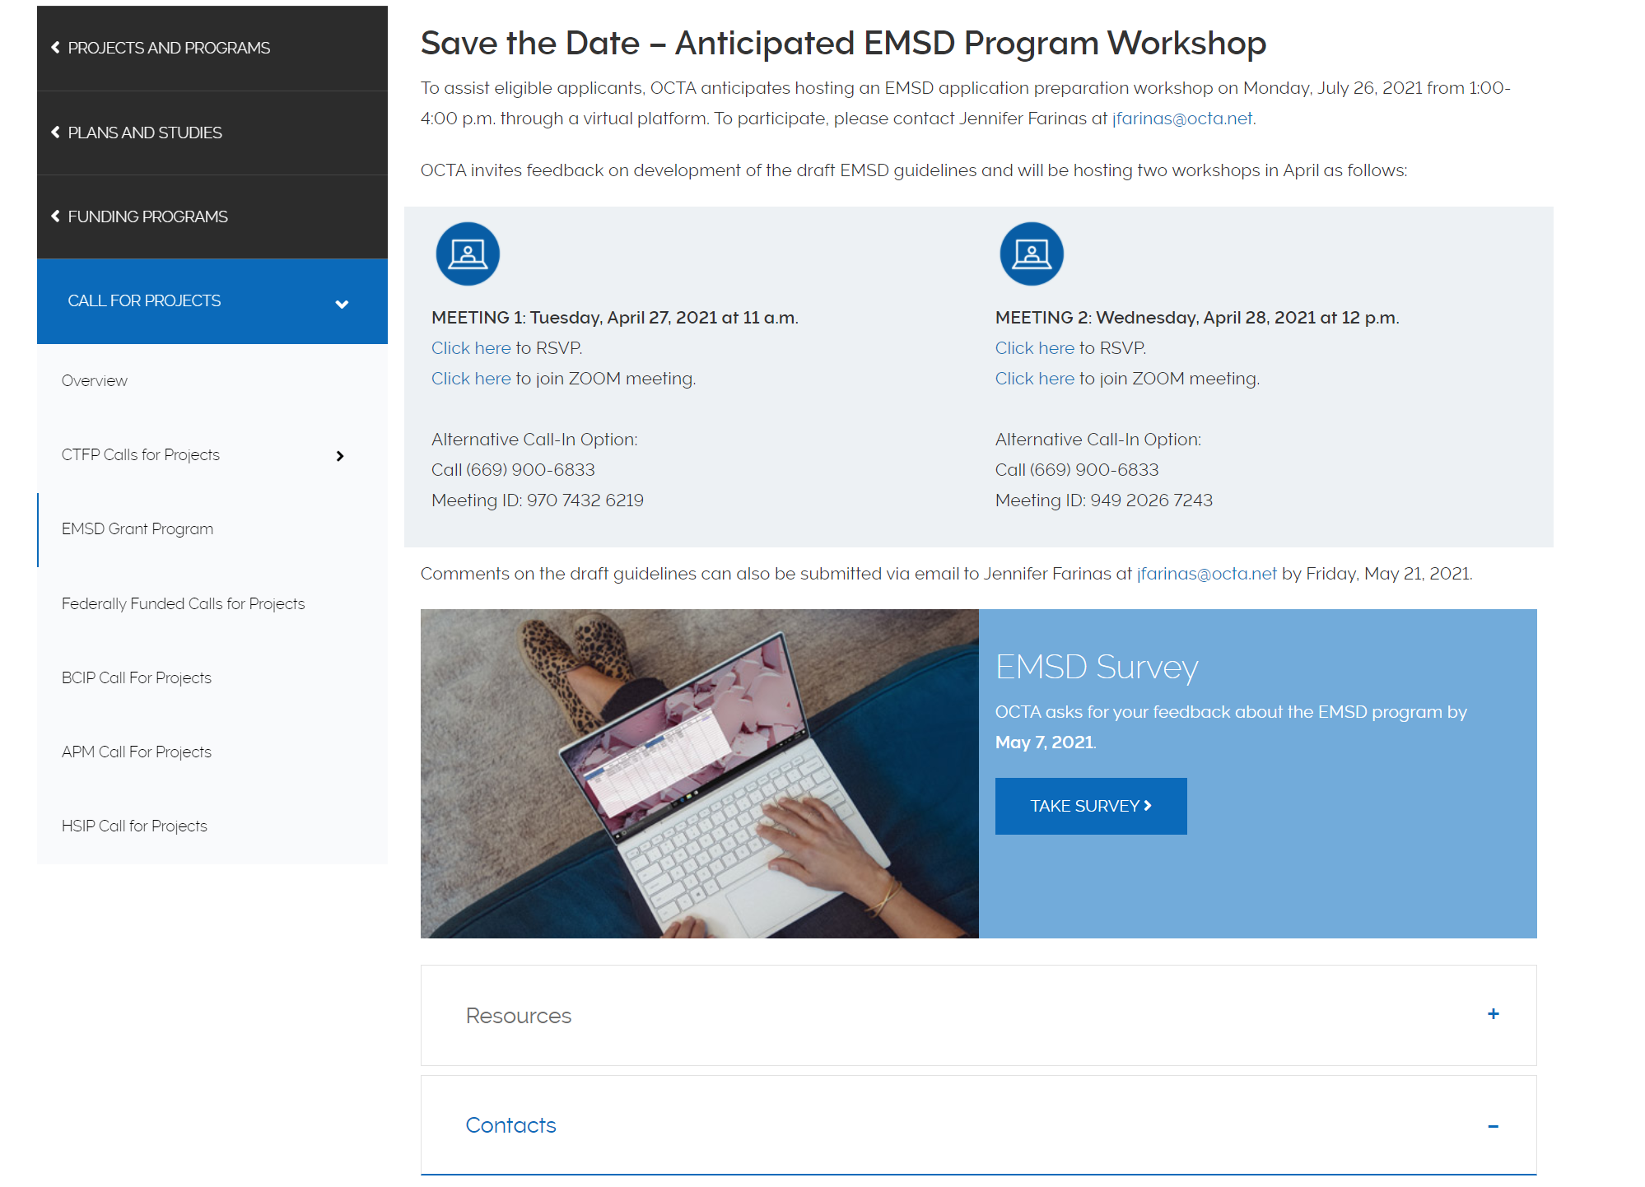
EMSD Program Webpage
Notes:
The Coordinated Plan is available under the Resources tab, which is just under the survey link and picture along with OCTA staff contact information.
Are there any final questions?
Please feel free to reach out to us if you have additional feedback or questions about the EMSD Call. Thank you very much for your time today. We look forward to continuing to partner with you.

