Slide 1
OC Streetcar Project Quarterly Update
Notes:
Good morning V Chair Jones and Board, I’m Jim Beil, Executive Director Capital Programs
I’ll provide an update on the construction of the OC Streetcar, Kelly Hart will update you on the vehicle production and O&M contract, and Tresa Oliveri will discuss our extensive outreach efforts.

Slide 2
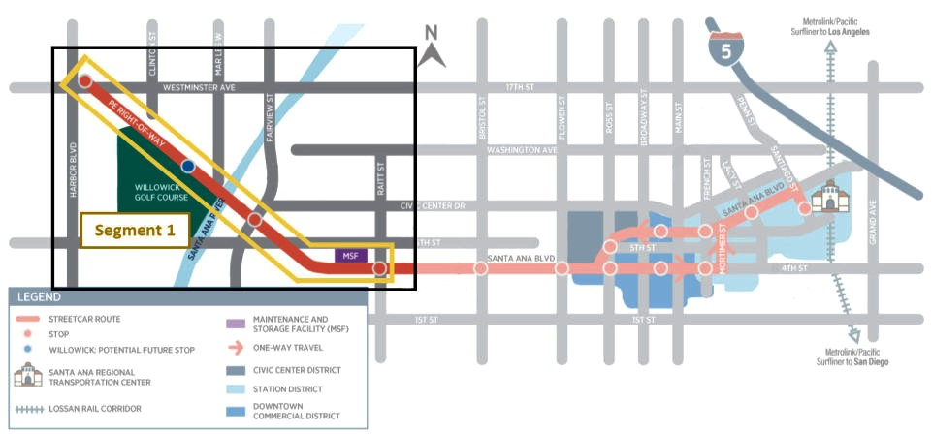
Construction—Segment 1
Pacific Electric Right-of-Way
  Hazardous soil disposal completed in July; sticks of rail delivered and are being welded into strings
Westminster Bridge
  Bridge deck concrete placement; final bridge approach retaining walls; temporary false work removal next quarter
Santa Ana River Bridge
  Bridge deck concrete placement; completed bridge approach retaining walls
Maintenance and Storage Facility
  Service and inspection pit delayed due to quality non-compliance; began construction of wash building sump pits and foundations
Notes:
The construction is broken down into logical segments by location and character of work.
Seg 1 on the westerly side is the OCTA rail ROW between Harbor and Raitt St., and includes the MSF. This segment is also where the initial vehicle testing will take place upon vehicle delivery.
In this segment, bridge foundation work is underway in the SA River and Westminster Ave., and the MSF underground utility and foundation construction has begun.
Grading work throughout this segment has commenced, and there is significantly more than anticipated contaminated soil in the top layer of dirt (arsenic) within the PEROW which needs to be removed. We will continue to assess and this may exceed the dollar value of allowance we built into the contract.

Slide 3
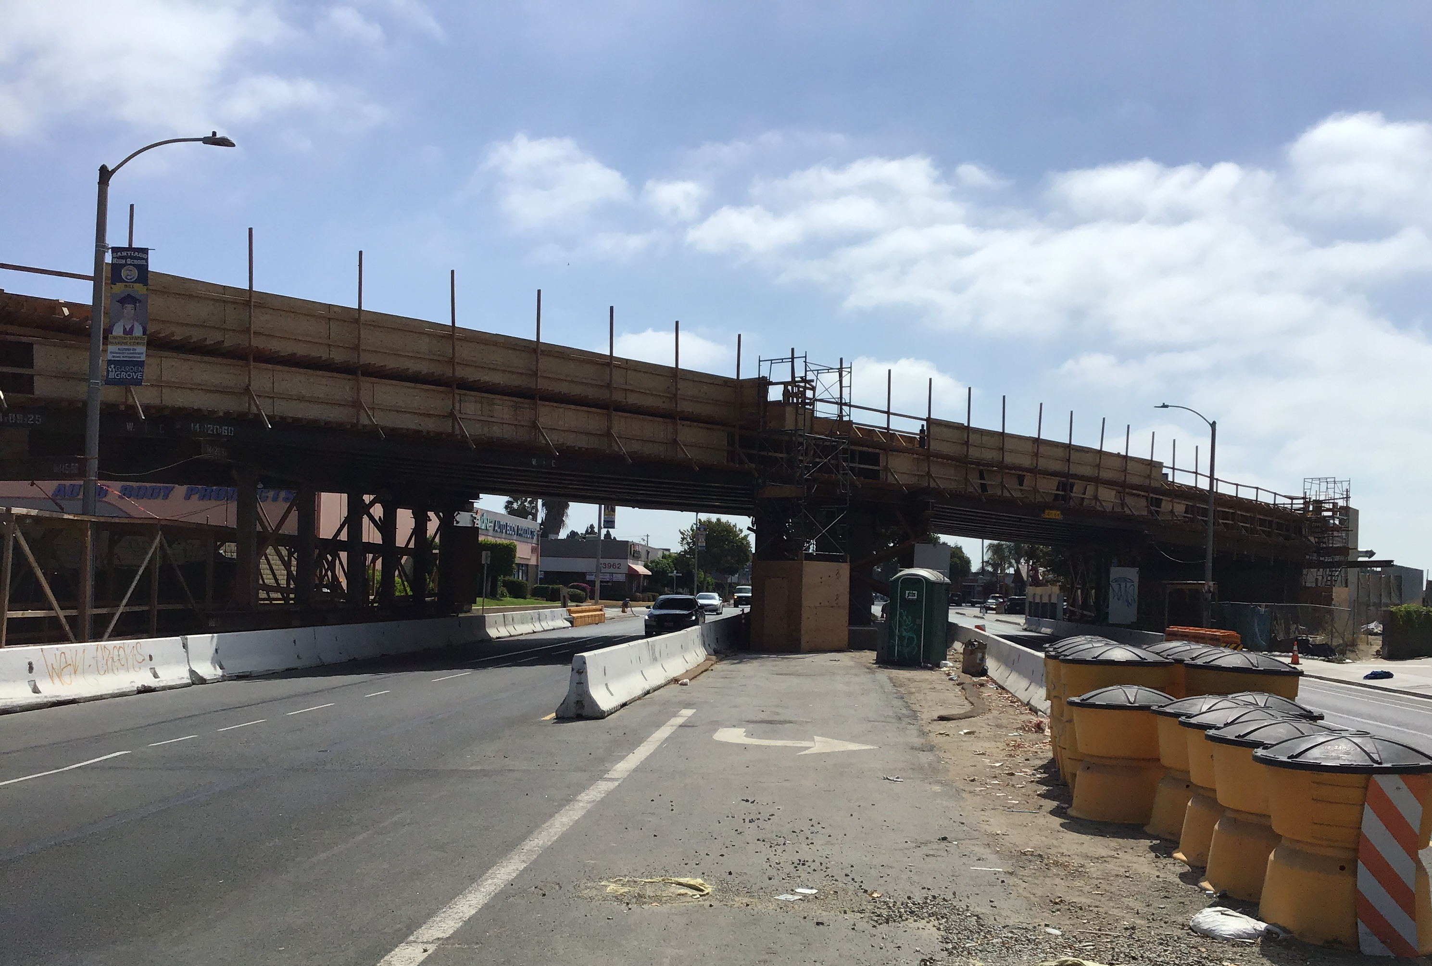
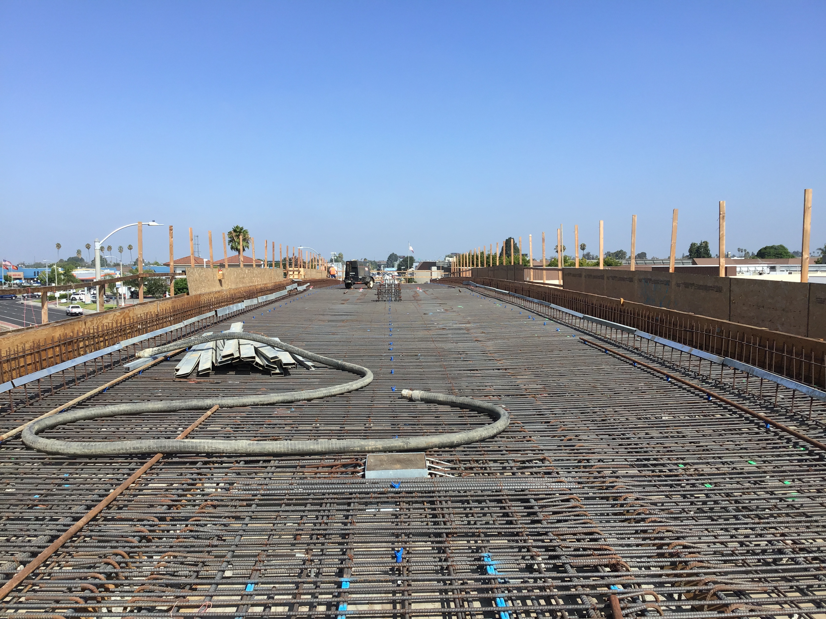
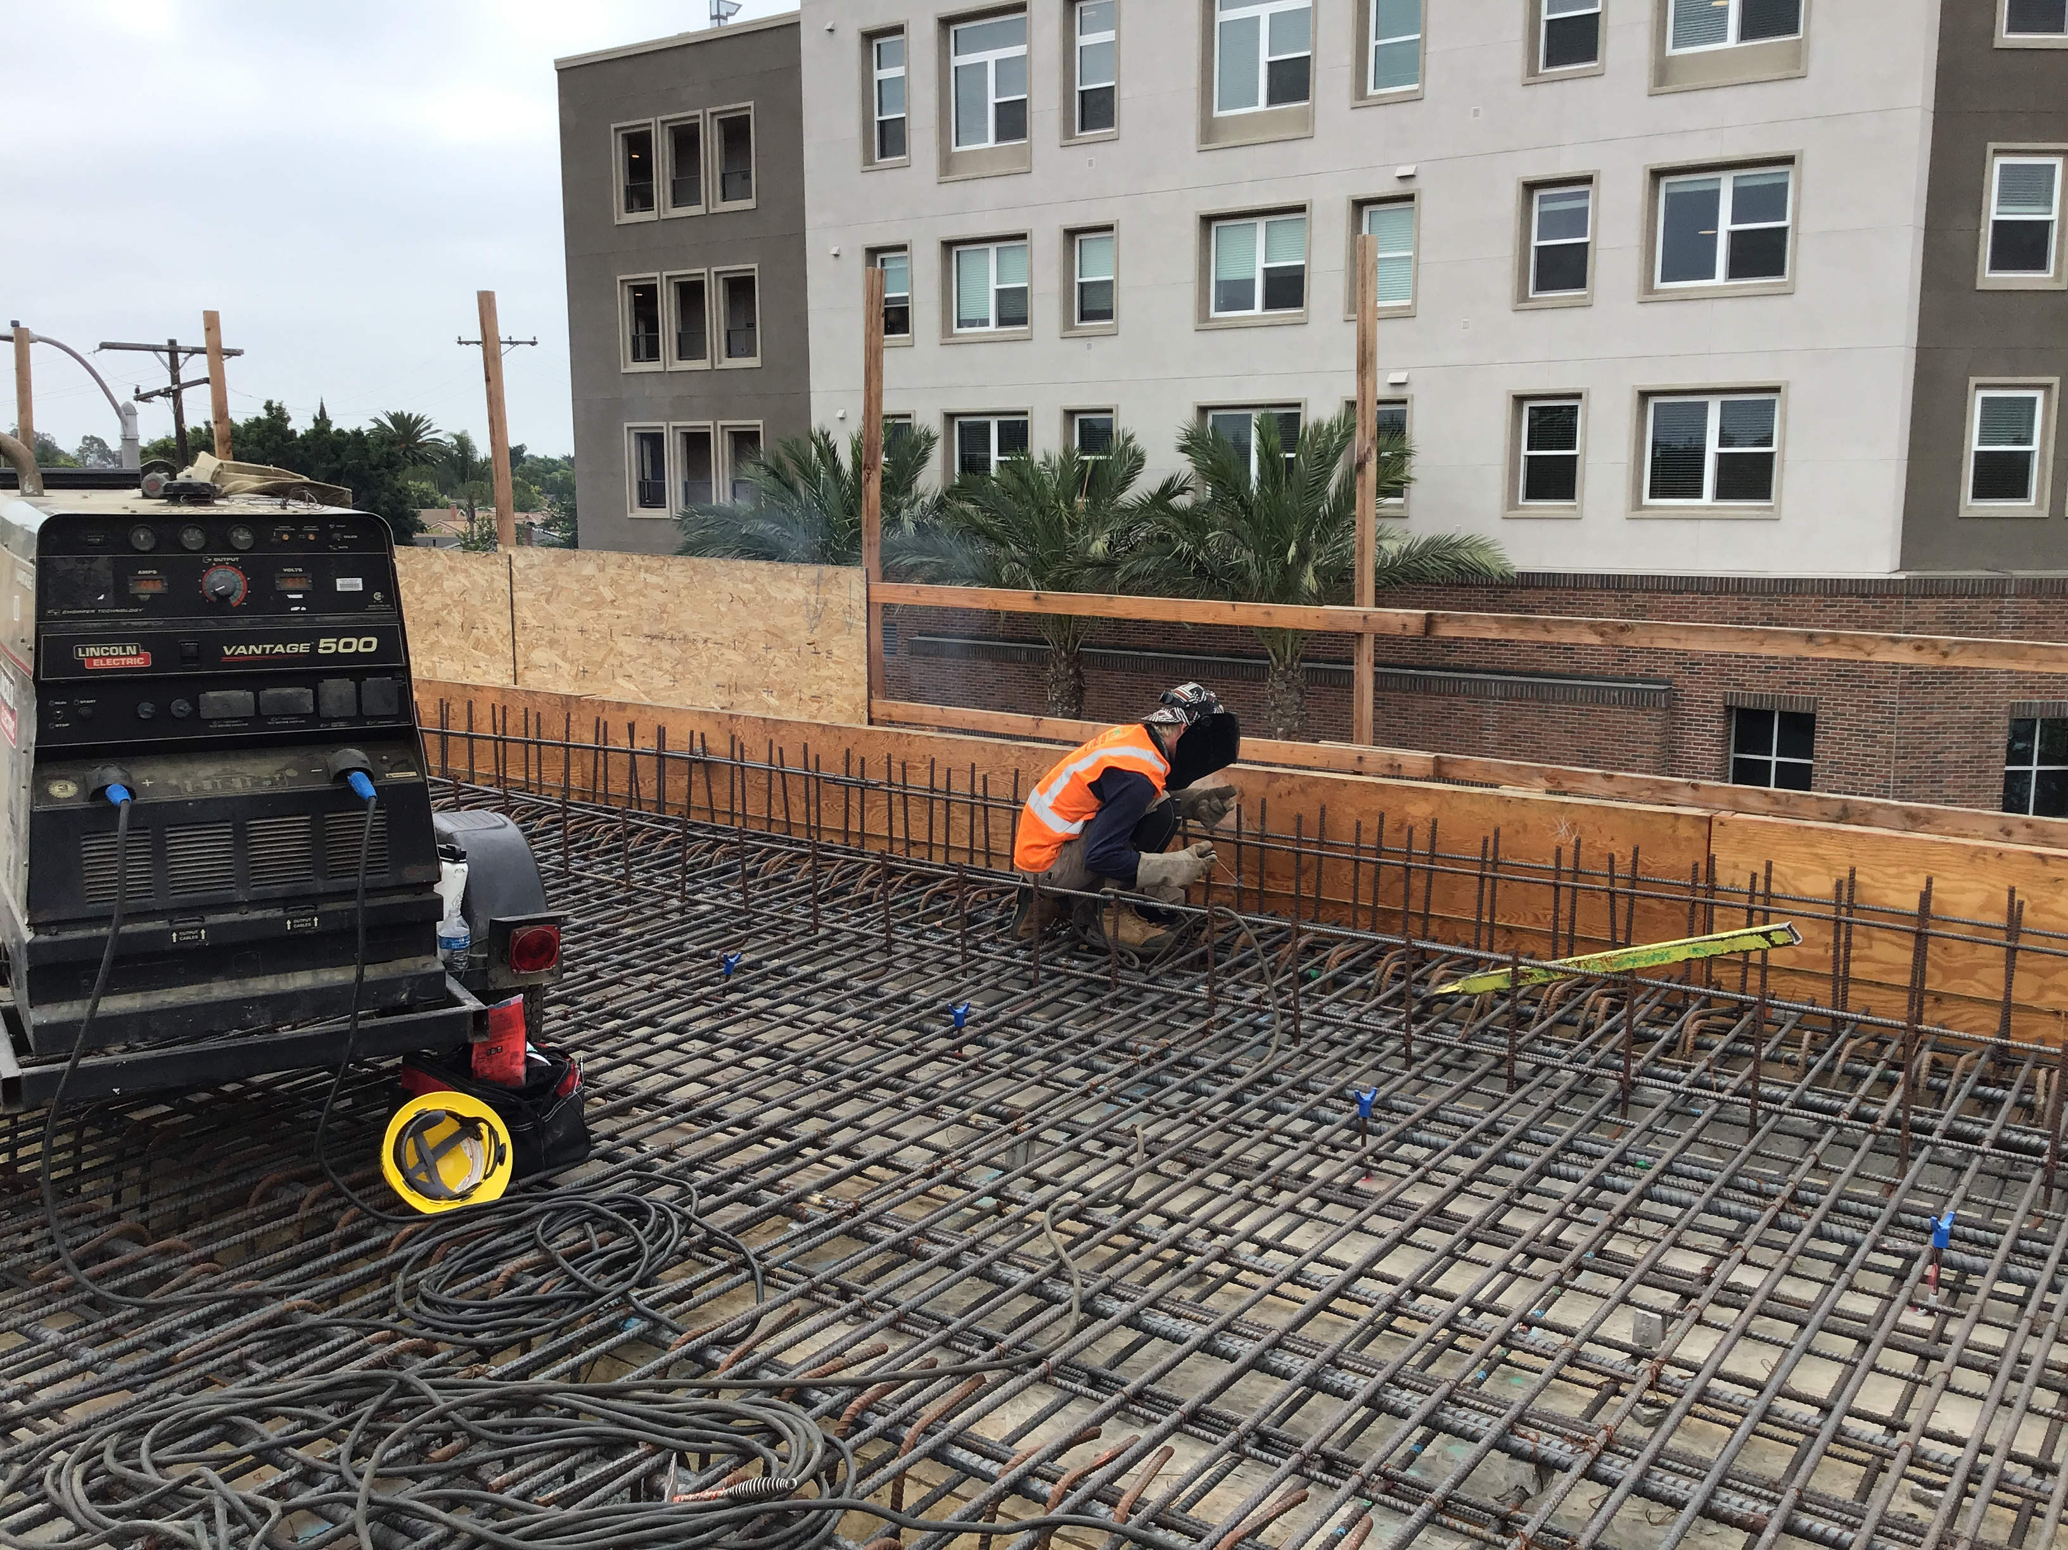
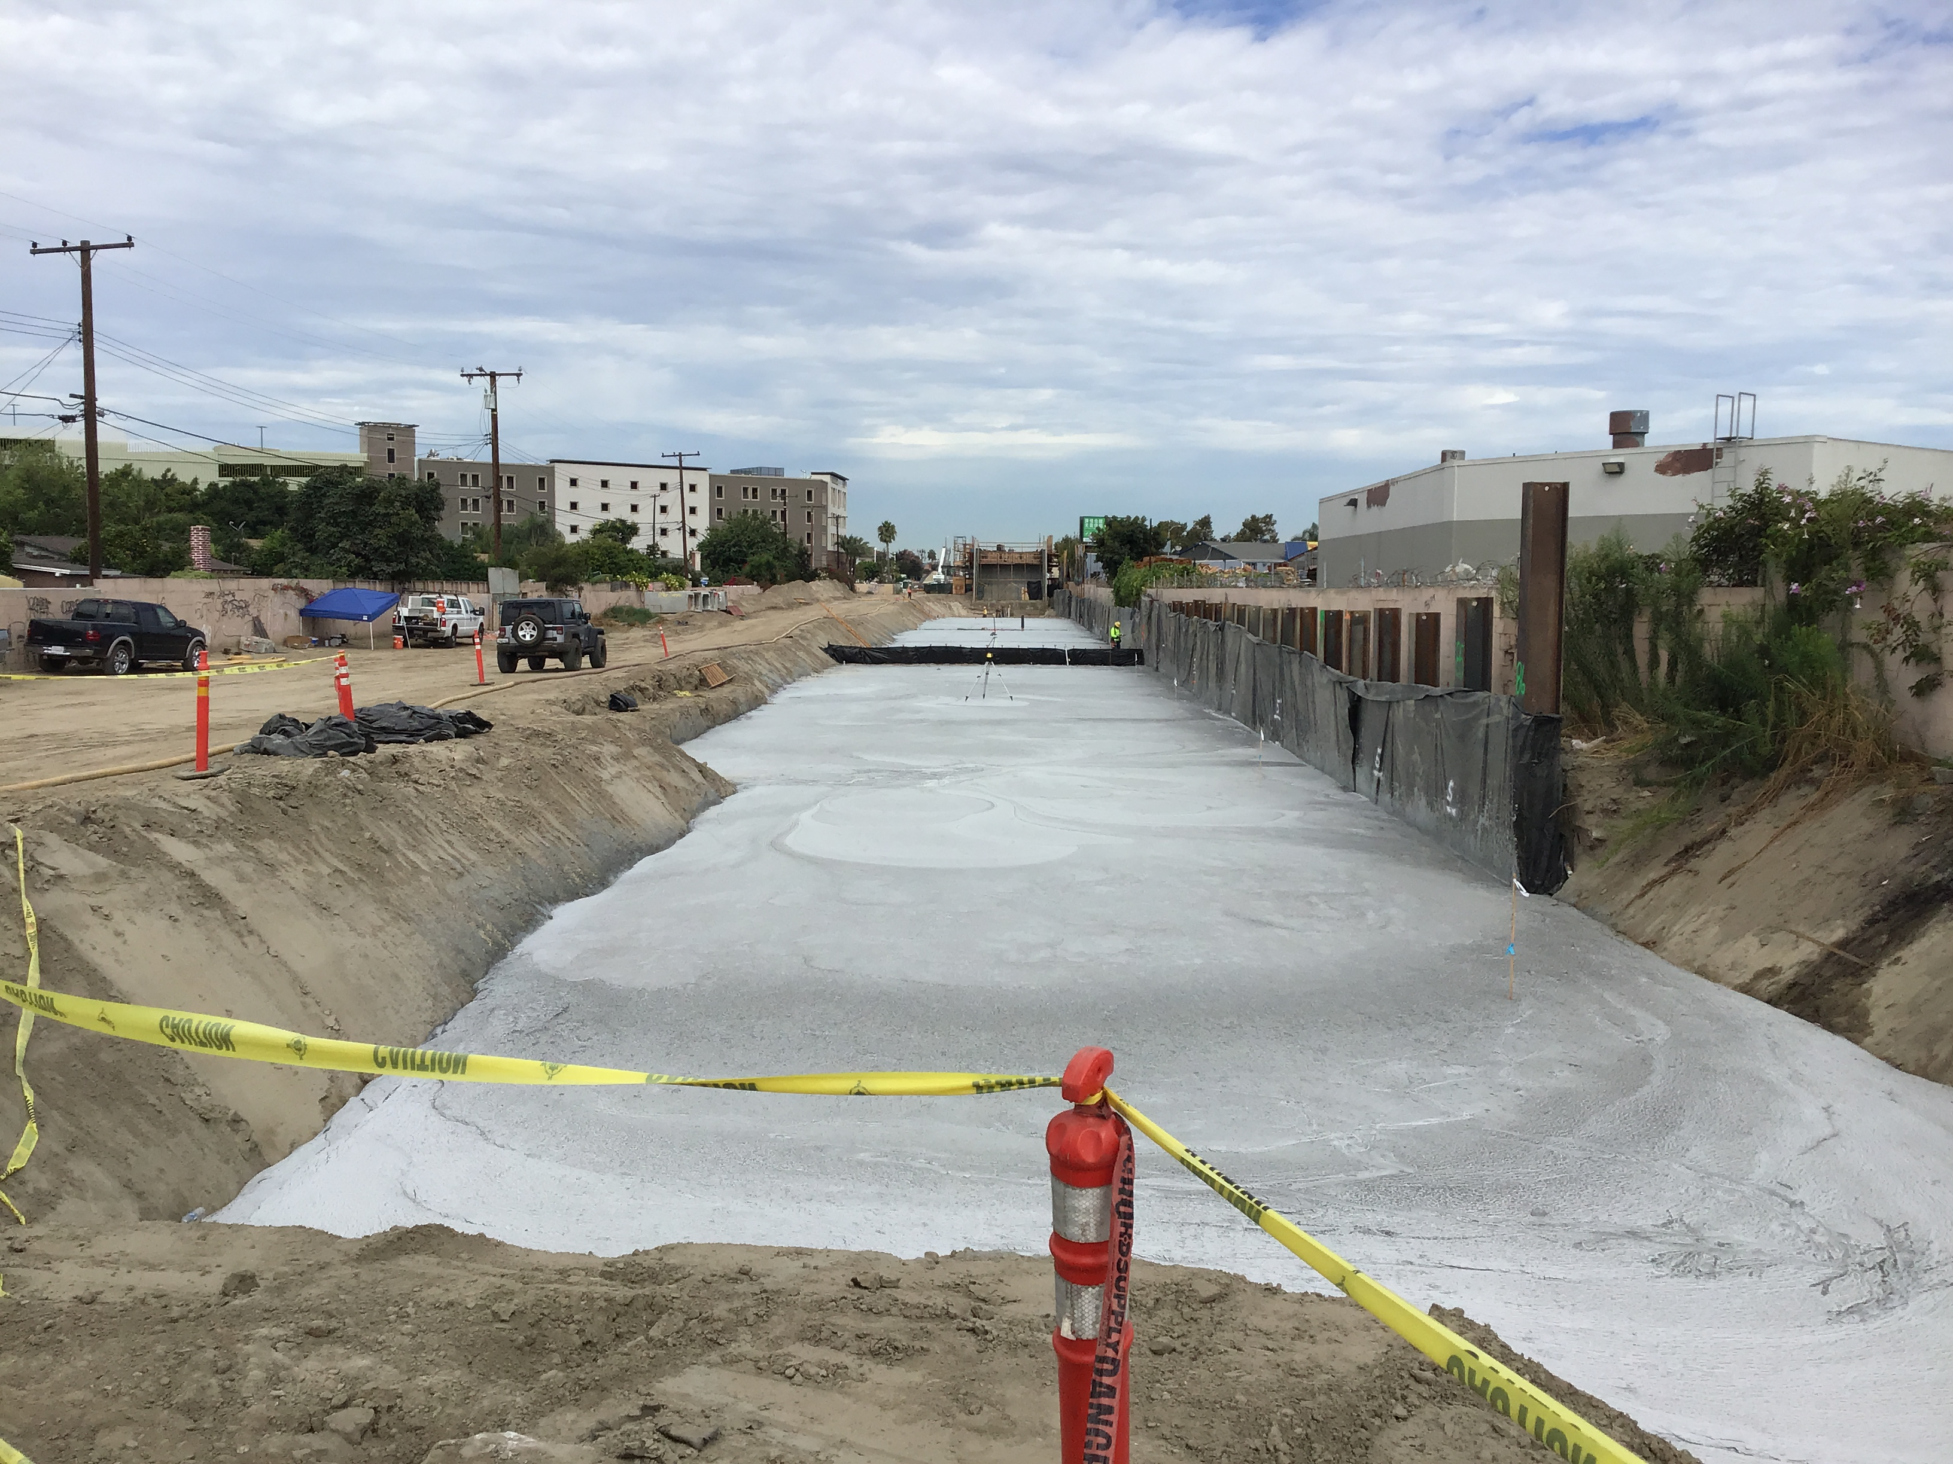
Westminster Bridge

Slide 4
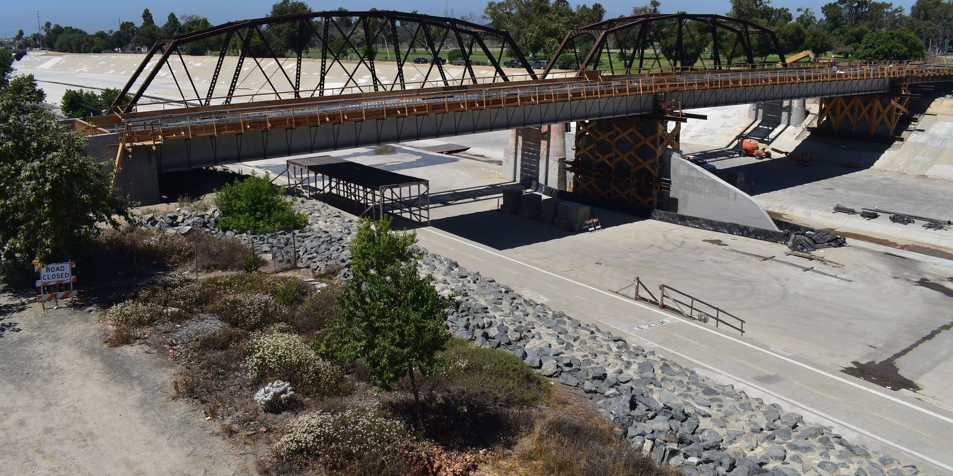
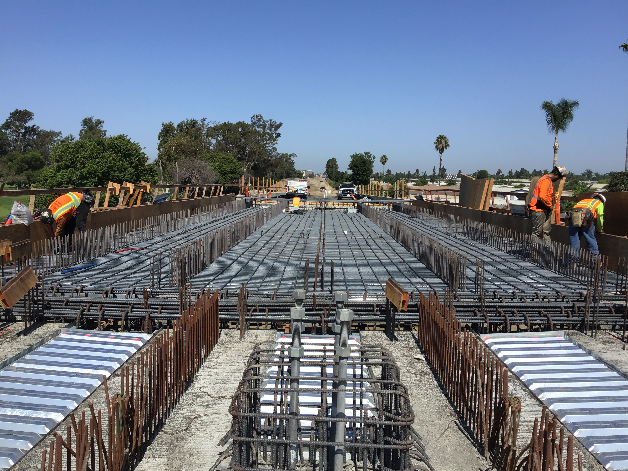
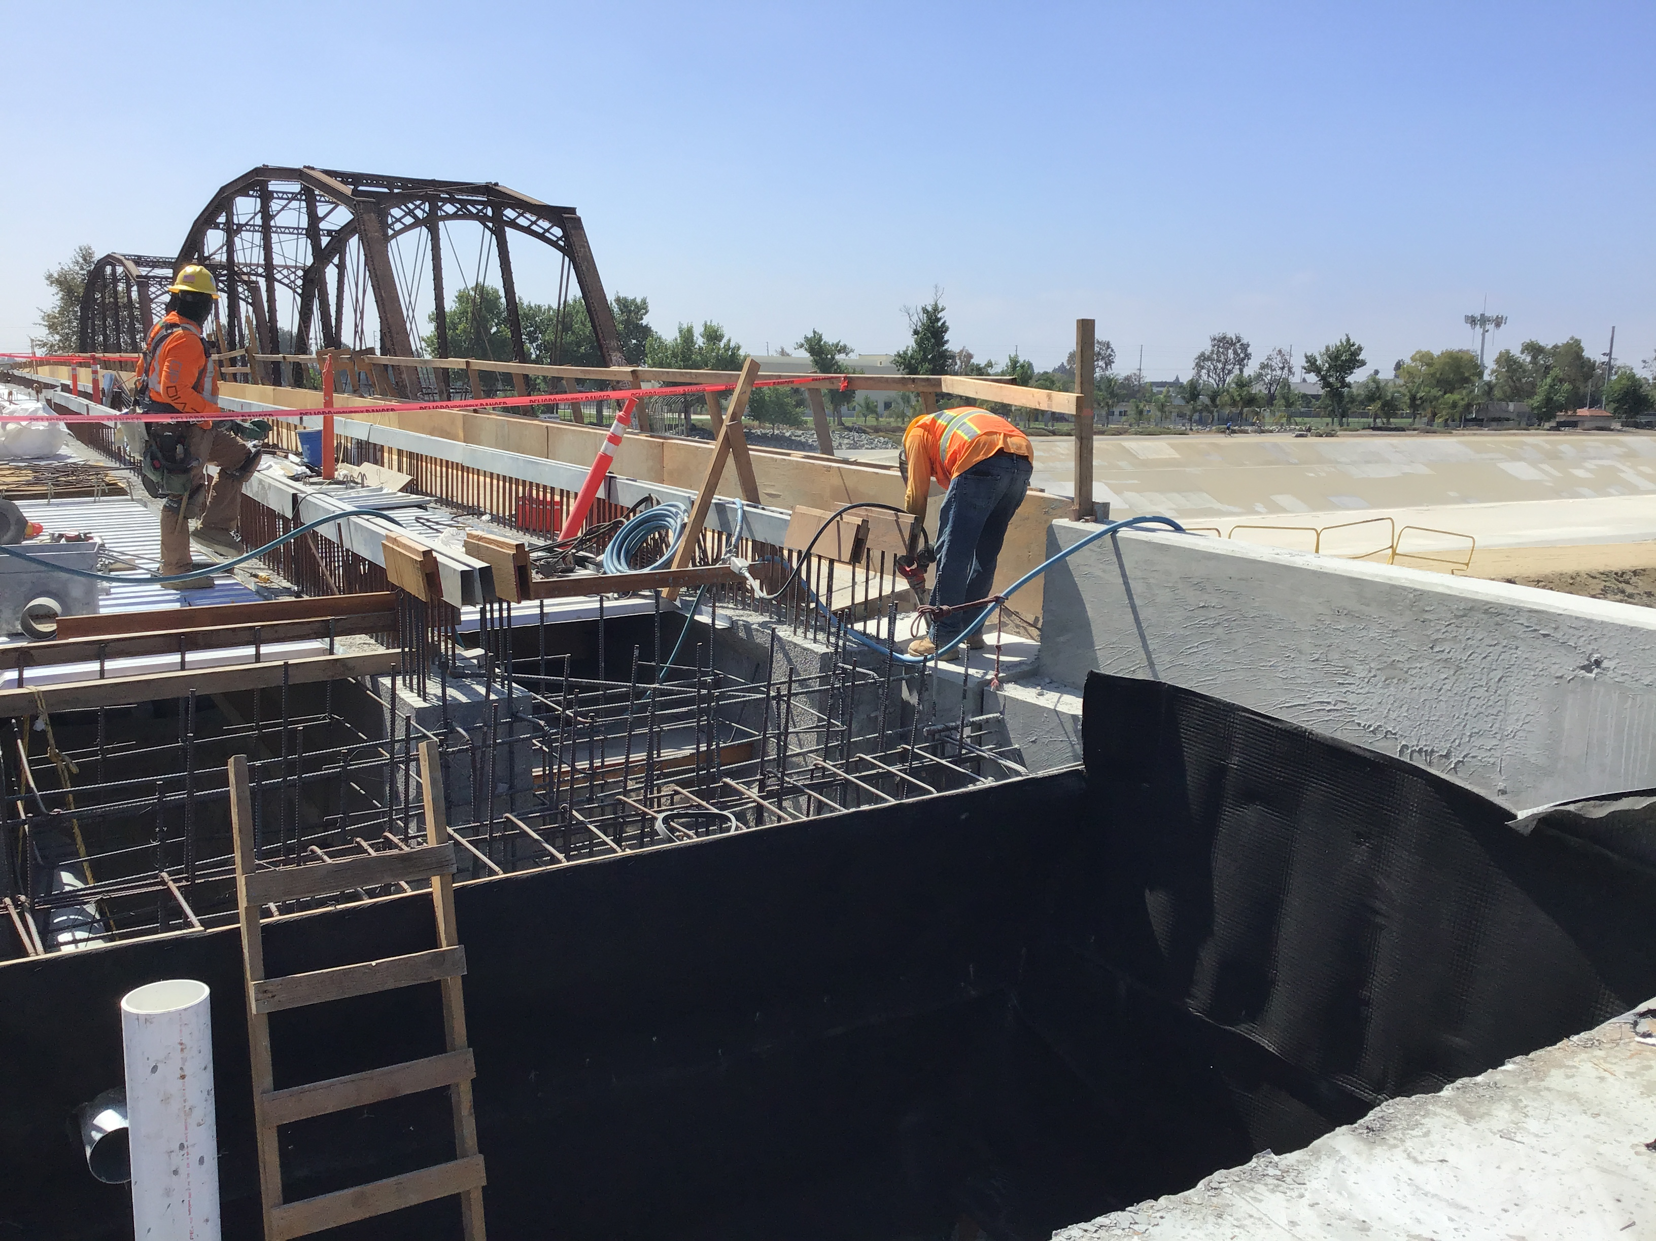
Santa Ana River Bridge
Notes:
We have two fixed job site cameras at key locations that documents activities every 15 minutes.
This is a recent photo looking southwest at the SA River bridge foundation work. You can see the historic PEROW steel Pegram truss bridge (chords same length at top but longer at bottom) immediately adjacent to our work.
The foundation includes a number of CIDH foundation piles which are 36” diameter and up to 90’ long. A hole is drilled, steel reinforcement is dropped in the hole, and concrete is placed. You can see a rebar cage laying on it’s side in the river bottom.

Slide 5
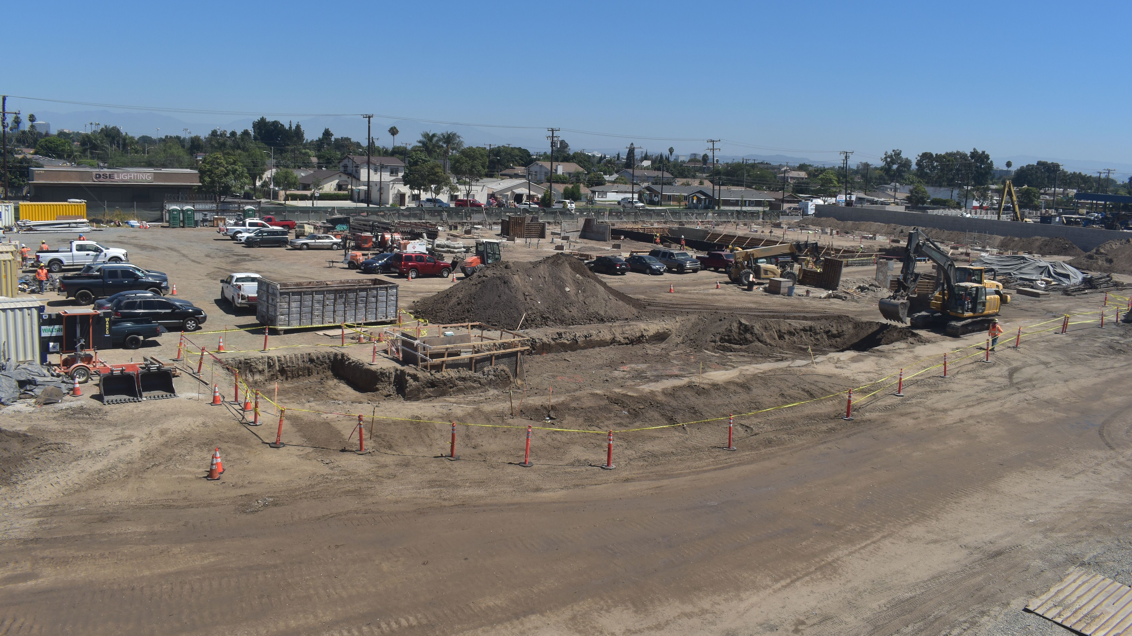
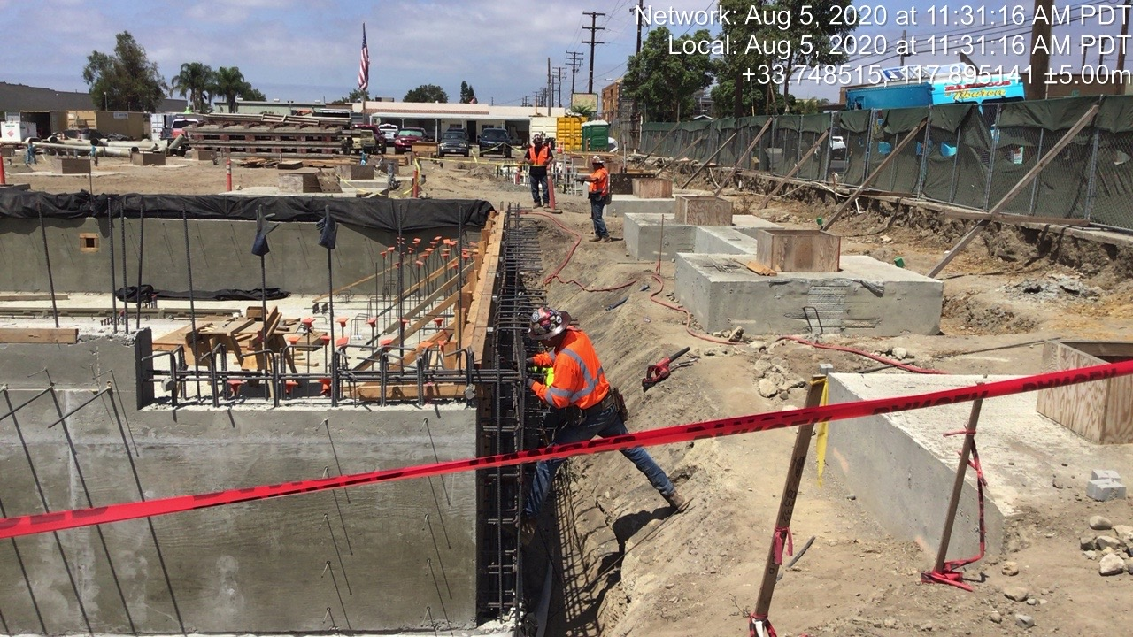
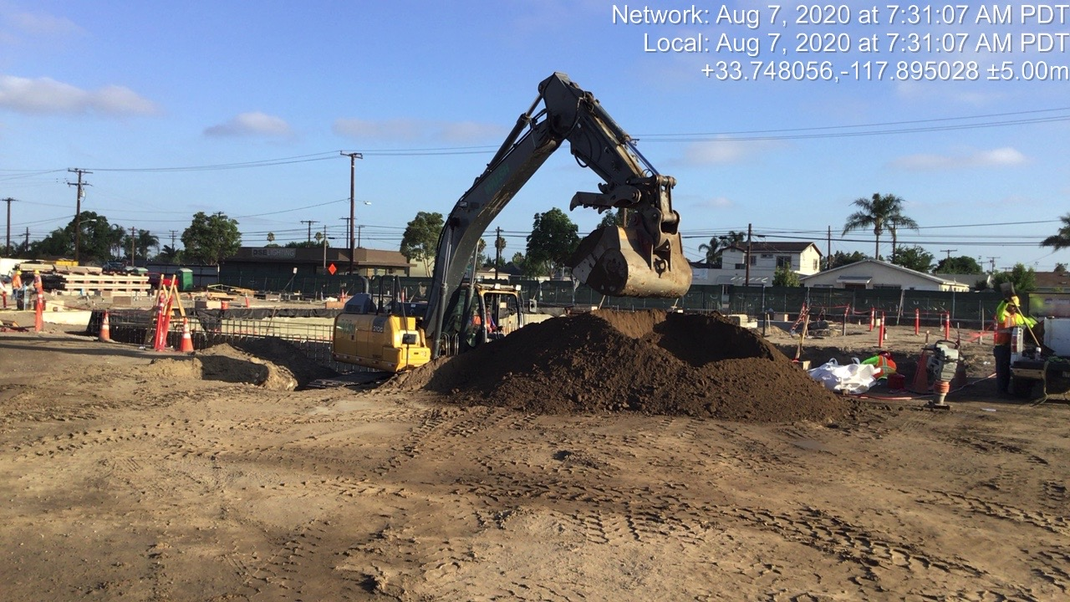
Maintenance and Storage Facility (MSF)
Notes:
This is a photo looking northeast at the MSF construction site which fronts Fifth St. on the northerly side in the background.
Underground utility and foundation construction has begun.
The plastic covered piles of dirt are the hydrocarbon and lead contaminated soil to be trucked out as outlined in the CO you approved in item #10 on todays agenda. There have been time impacts due to the removal which we are still assessing.
On July 11th during excavation on this site, an old UST was discovered next to 5th St. and is being removed. Also, an undocumented water well was discovered and will be properly abandoned. We are assessing cost and schedule impacts for these.
There are a number of early issues effecting schedule and we will be working with Walsh to recover time.

Slide 6
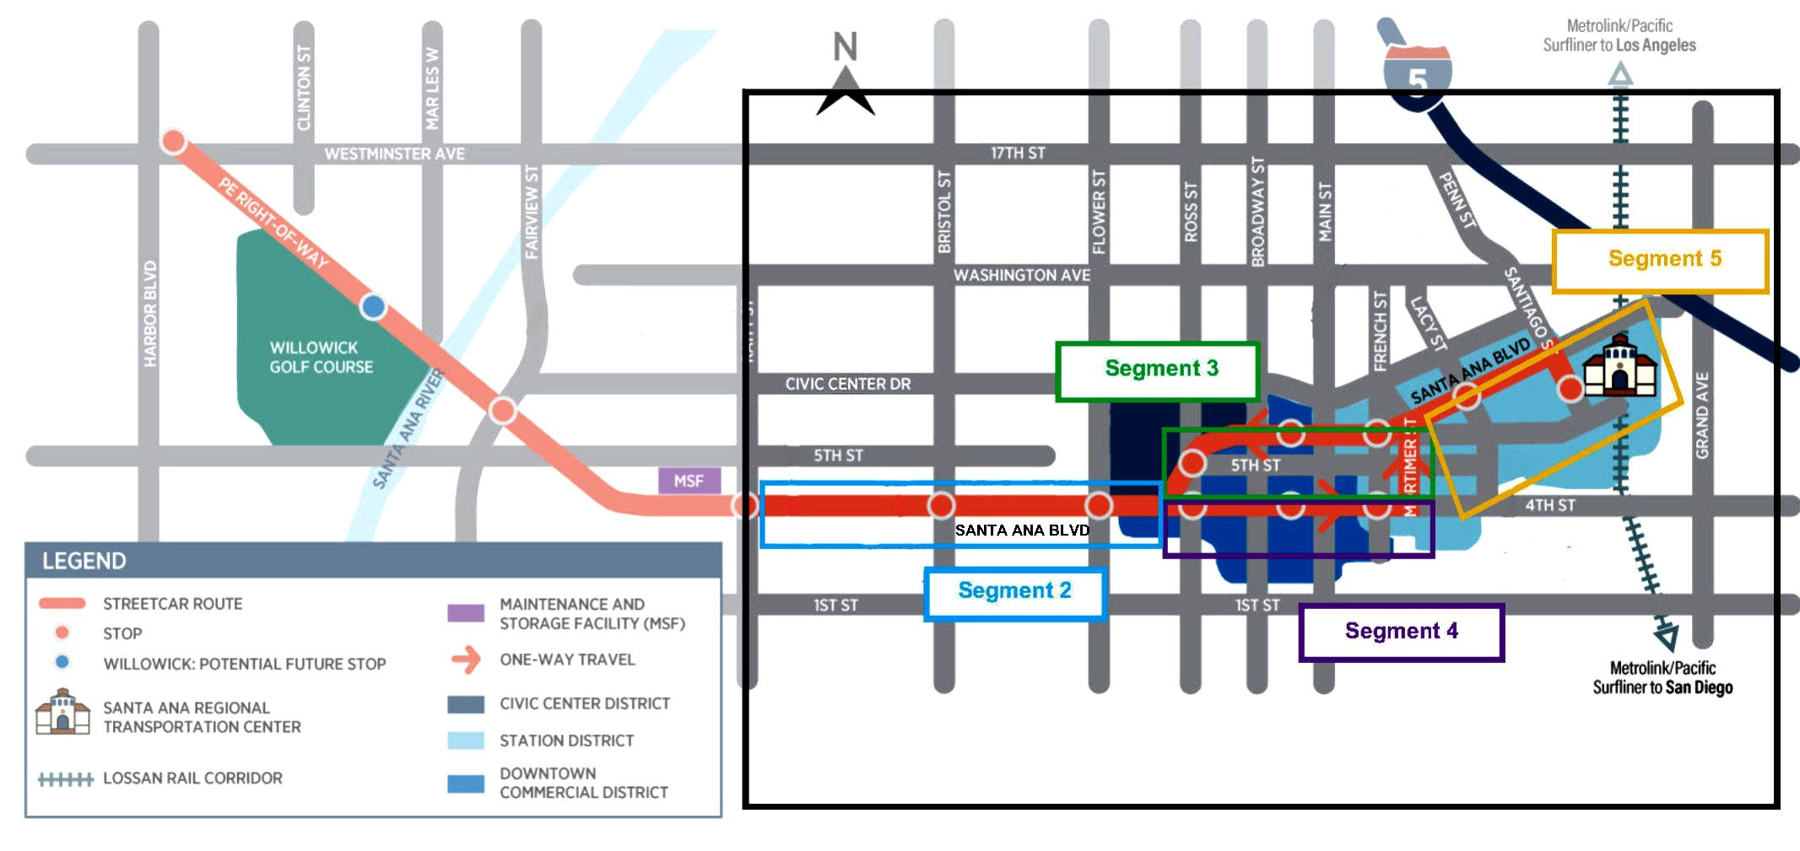
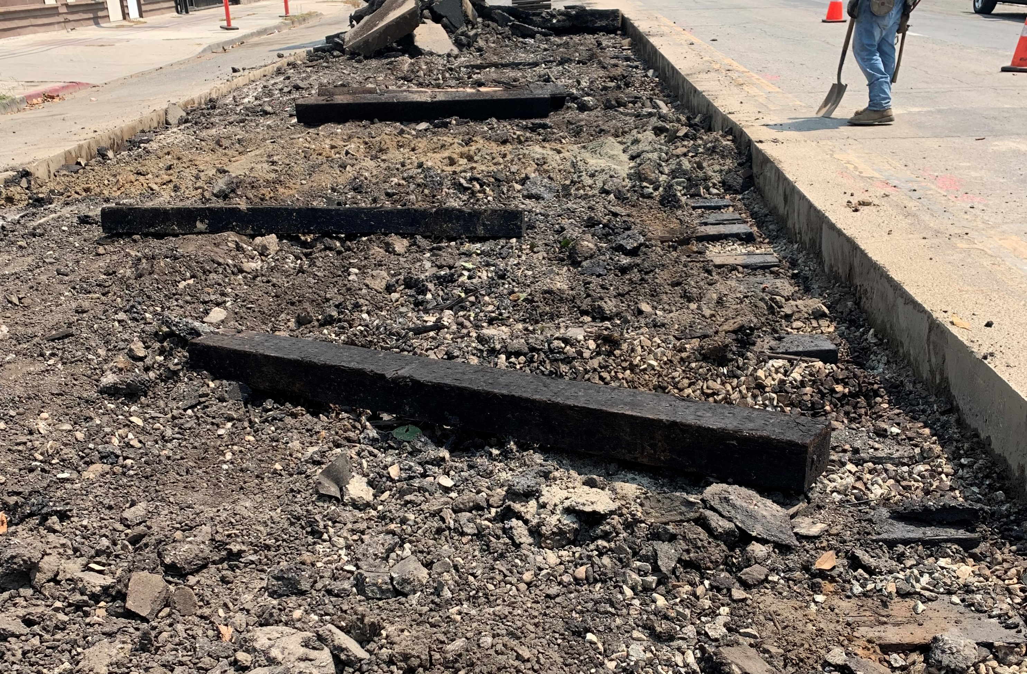
Construction—Segments 2 Through 5
Wet utility relocation nearing completion
    Rehabilitate sewer main on Santa Ana Boulevard between Broadway Street and Mortimer Street, install new sewer line on 4th Street at French Street
    Finalizing water service connections
    Installing new storm drain on Main Street
    Excavation for westbound embedded track slab on Santa Ana Boulevard from Raitt Street to Bristol Street
    Installation of overhead contact system (OCS), traffic signal, and streetlight pole foundations
Notes:
Segments 2, 3, 4, and 5 are in-street running segments between Raitt on the left and the train station on the right.
Each of these segments has a bit of different character, complexities, and stakeholders.
Seg 2 (blue box) is on west SA Blvd. between Flower and Raitt, and is primarily residential.
Sewer and water line relocation is on-going in this segment.
Seg 3 (green box) is the one-way WB SA Blvd couplet between Mortimer and Ross, and runs along the Federal, State, County, and City Civic Center areas.
Water line relocation and storm drain work are also current in this segment.
Seg 4 (purple box) is the one-way eastbound Fourth St. couplet between Sasscer Park and Mortimer, which is the old downtown SA business area.
Utility and water line relocation is on-going.
Seg 5 (yellow box) is on east SA Blvd. between Mortimer and the train station, is primarily residential.
Sewer line relocation has started in this section.

Slide 7
Project Challenges
Unforeseen utility conflicts
Contaminated soils and materials in Pacific Electric
Right-of-Way (PEROW) and city streets
Compliance with quality requirements
Oversight and approvals from multiple agencies and third parties
Dispute resolution and change management
Schedule impacts and higher use of contingency than anticipated

Slide 8
Upcoming Construction Milestones
Installation of in-street embedded track and PEROW ballasted track
Installation of OCS poles
Continued construction of MSF slabs and walls
Site development of Fairview Street station stop platform
Pouring of the Santa Ana River Bridge deck
Complete retaining walls, post tensioning, and structural backfill at Westminster Bridge

Slide 9
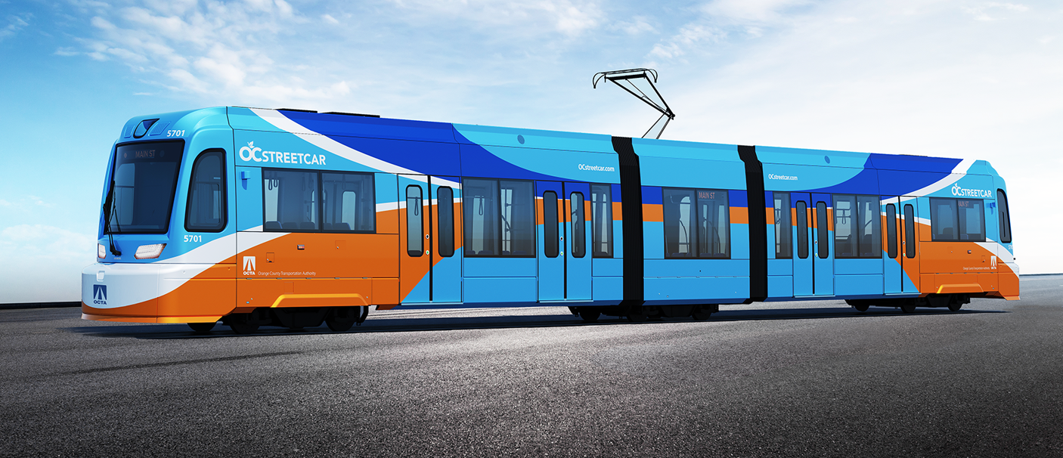
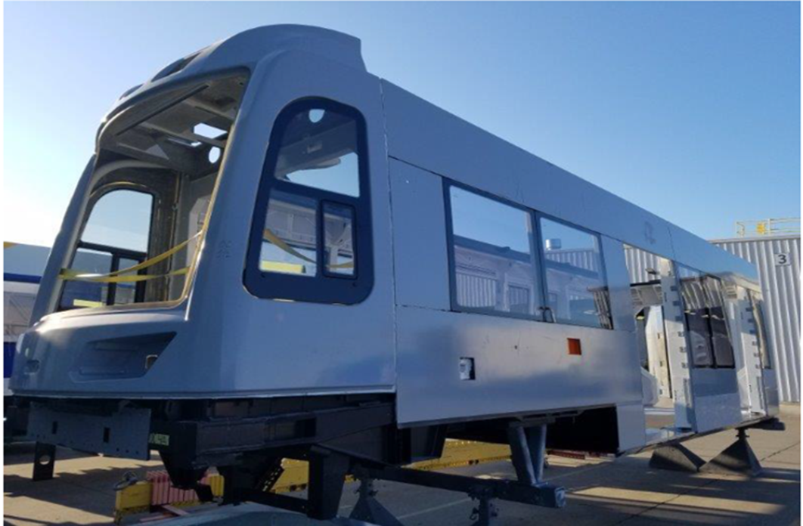
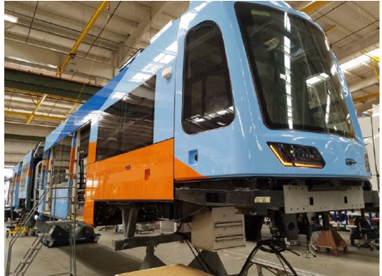
Vehicles
  All eight vehicles in various stages of production
  The first vehicle, Car 1, has completed several significant milestones during the quarter that include interior/exterior equipping, water testing, hi-pot wire size testing, continuity electrical testing, static testing, and dynamic testing
  Final design review of remaining vehicle components, including the energy absorbing bumper, emergency battery drive, and flange lube system
  Ongoing coordination with Conduent and Siemens on computer-aided dispatch and automated vehicle location design specifications
Notes:
Kelly

Slide 10
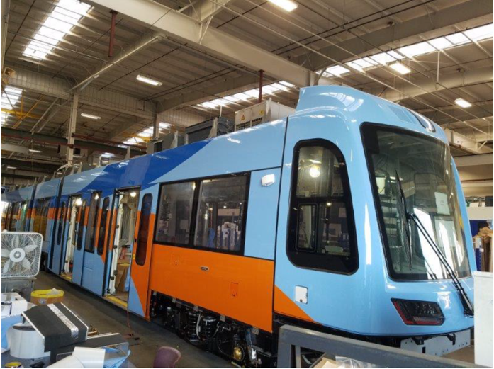
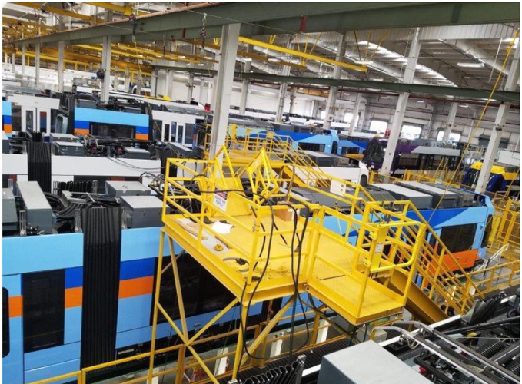
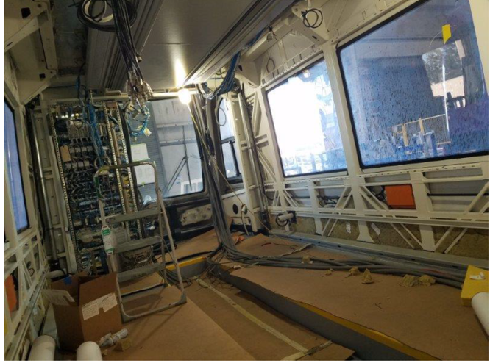
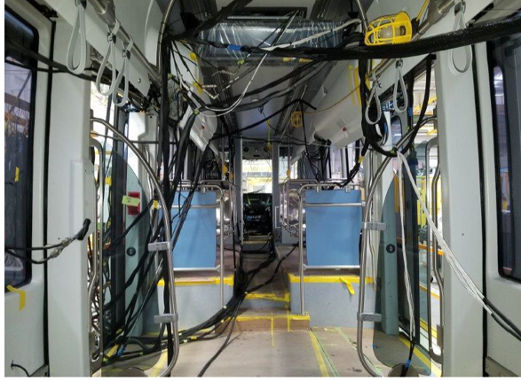
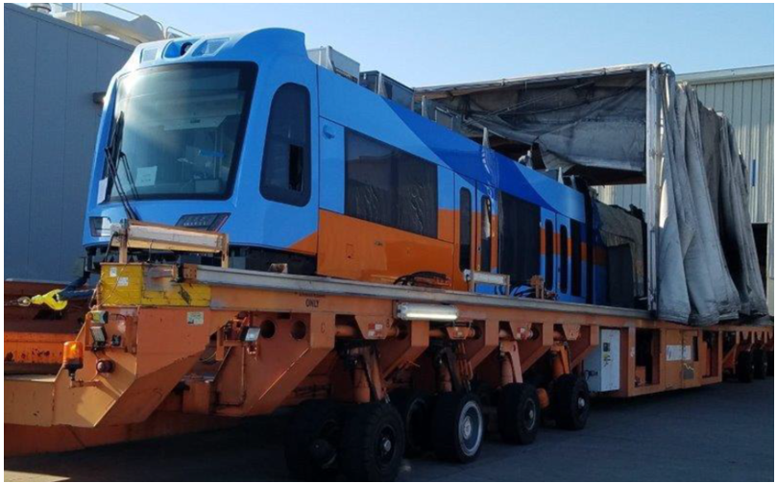
Vehicles

Slide 11
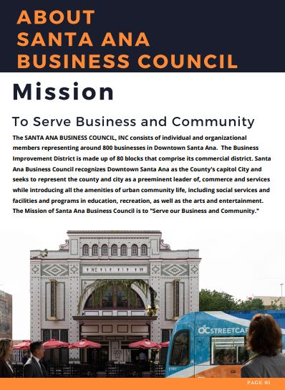
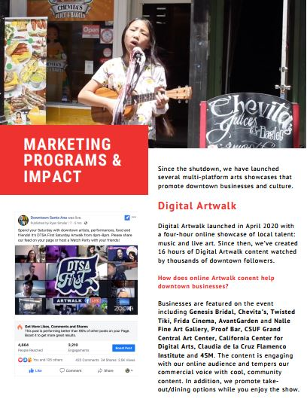
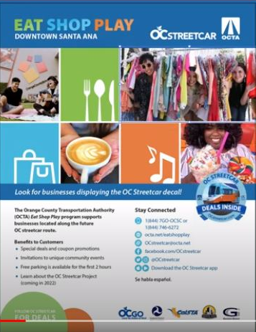
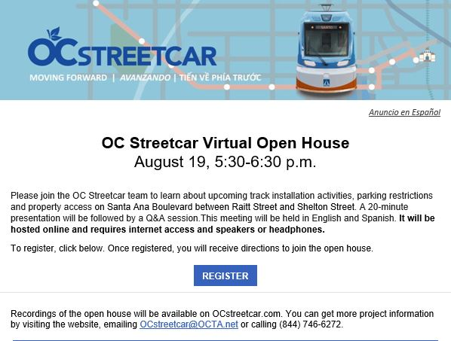
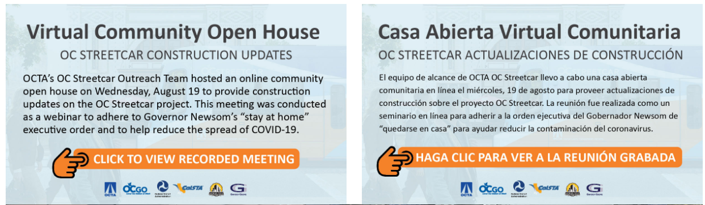
Outreach – Support
Santa Ana Business Association activities
Eat Shop Play Video
Virtual Open House
Notes:
The OC Streetcar outreach team has launched a tab on the OC Streetcar website to showcase the businesses that have signed up as a part of the Eat Shop Play program.
There are 23 businesses officially signed up as a part of the program, and six more businesses who are in the process of being signed up.
We’ve done 29 paid social media ads for businesses that have signed up for Eat Shop Play. Due to covid-19, many restaurants and other businesses in the downtown could only offer to-go orders, we pivoted to help promote those businesses.
A bilingual bi-weekly newsletter goes out to a database of over 2300 contacts, promoting different businesses and organizations that have signed-up for the Eat Shop Play program.

