Slide 1
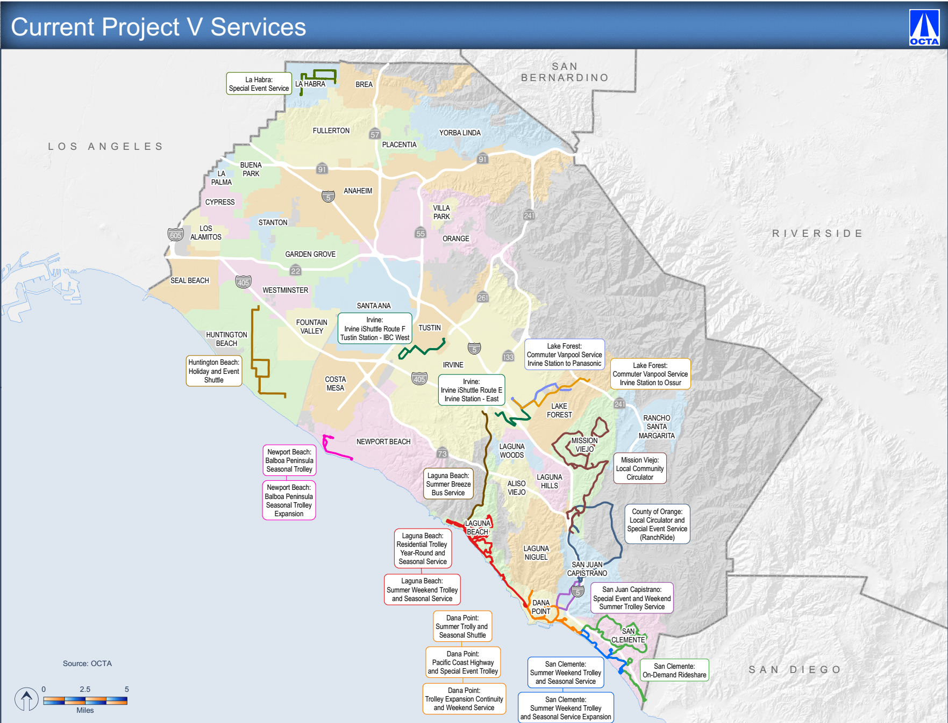

Slide 2
Performance Criteria and Monitoring
Key performance indicators:
Under-performing projects subject to cancellation
Reporting Requirements:
Ridership Reports – Quarterly
Updates provided to Transit Committee and OCTA Board – Semi-annually
¹ One Year from the first day of operations
B/RVH – Boardings per revenue vehicle hour
OCTA – Orange County Transportation Authority
Board – Board of Directors

Slide 3
Performance
Services meeting or exceeding the minimum established performance standard:
County of Orange - Local Circulator & Special Event Service
Dana Point - Summer Trolley & Seasonal Shuttle
Dana Point - Pacific Coast Highway & Special Event Trolley
Huntington Beach - Holiday & Event Shuttle
Laguna Beach - Summer Weekend Trolley & Seasonal Service
Laguna Beach - Summer Breeze Bus Service
Lake Forest - Commuter Vanpool Irvine Station & Ossur
Lake Forest - Commuter Shuttle Irvine Station & Panasonic
Newport Beach - Balboa Peninsula Seasonal Trolley
Newport Beach - Balboa Peninsula Seasonal Trolley Expansion
San Clemente - Summer Weekend Trolley & Seasonal Service
San Clemente - Summer Weekday Trolley & Seasonal Service Expansion
San Juan Capistrano - Special Event & Weekend Summer Trolley Service
San Clemente - On-Demand Services
Services in Initial Start Up Period:
Dana Point – Trolley Continuity and Expansion Weekend Service
Irvine – iShuttle Route 404 E
Irvine – iShuttle Route 405 F
Services below the minimum established performance standard:
Laguna Beach- Weekend Residential Trolley Service
Mission Viejo - Local Community Circulator

