Slide 1
Costa Mesa Freeway (SR-55) Improvement Project I-405 to I-5

Slide 2
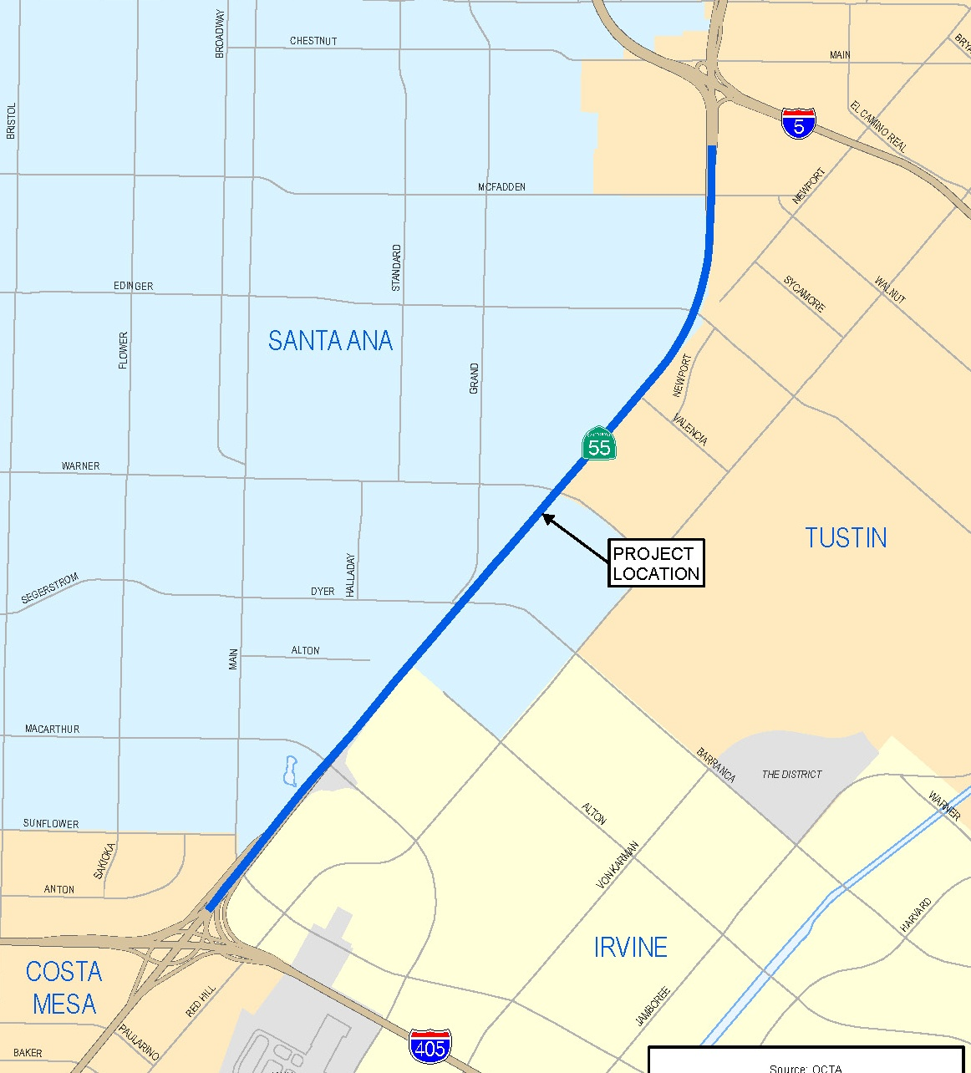
I-5 to I-405 Segment Area
End project
Begin project

Slide 3
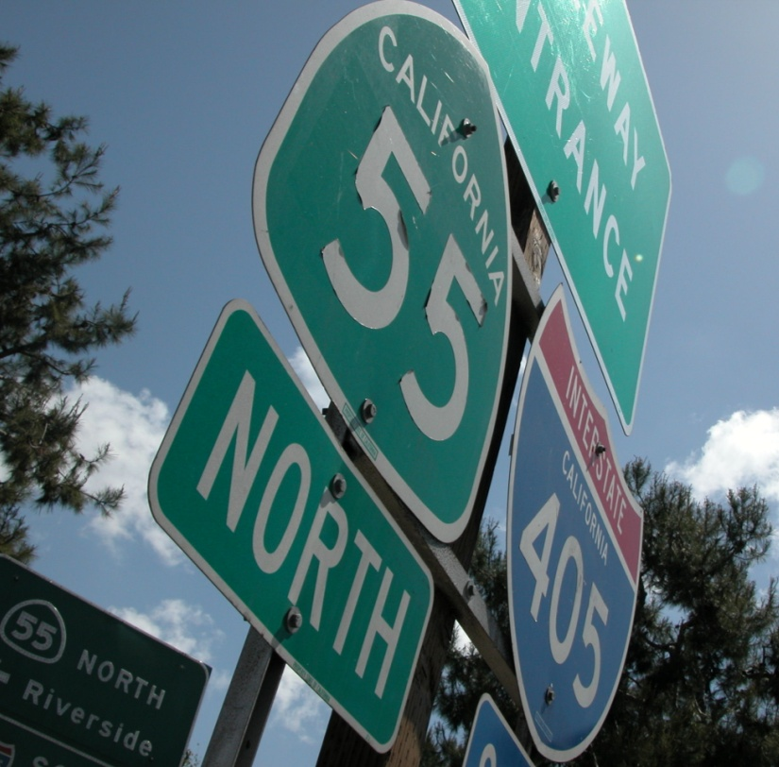
SR-55 between I-5 and I-405 Overview
Borders Santa Ana, Irvine & Tustin
Partnership with OCTA & Caltrans
Funded by Renewed Measure M
Existing conditions
4 general purpose lanes
1 high-occupancy vehicle lane
295,000 average daily vehicles

Slide 4
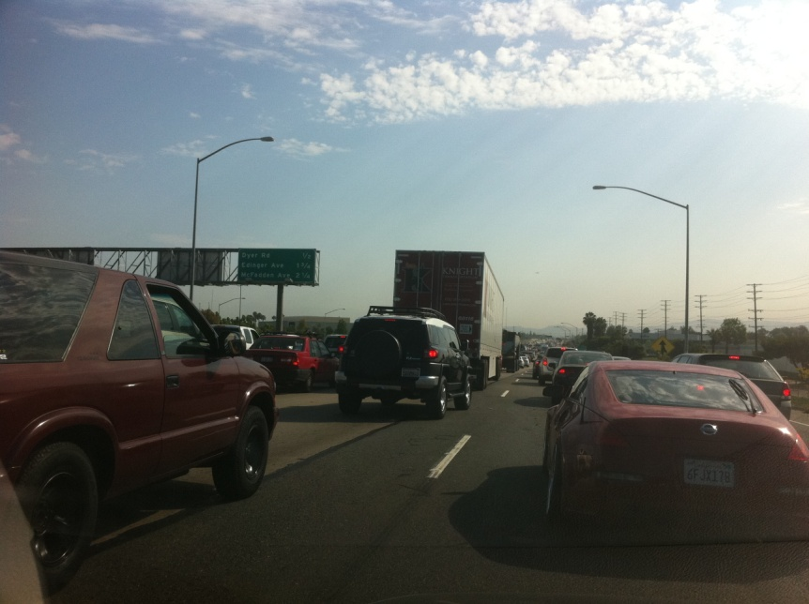
Key Project Goals
Increase freeway capacity
Reduce congestion
Increase mobility
Deliver operational improvements between interchanges

Slide 5
Proposed Build Alternatives
Alternative 1
Add auxiliary lane between each interchange
Alternative 2
Add fifth general purpose lane in both directions
Alternative 3
Combines alternatives 1 and 2
Alternative 3 Modified
Add one general purpose lane, one carpool lane and auxiliary lanes in each direction
Alternative 4
Add carpool lane, auxiliary lanes in each direction

Slide 6
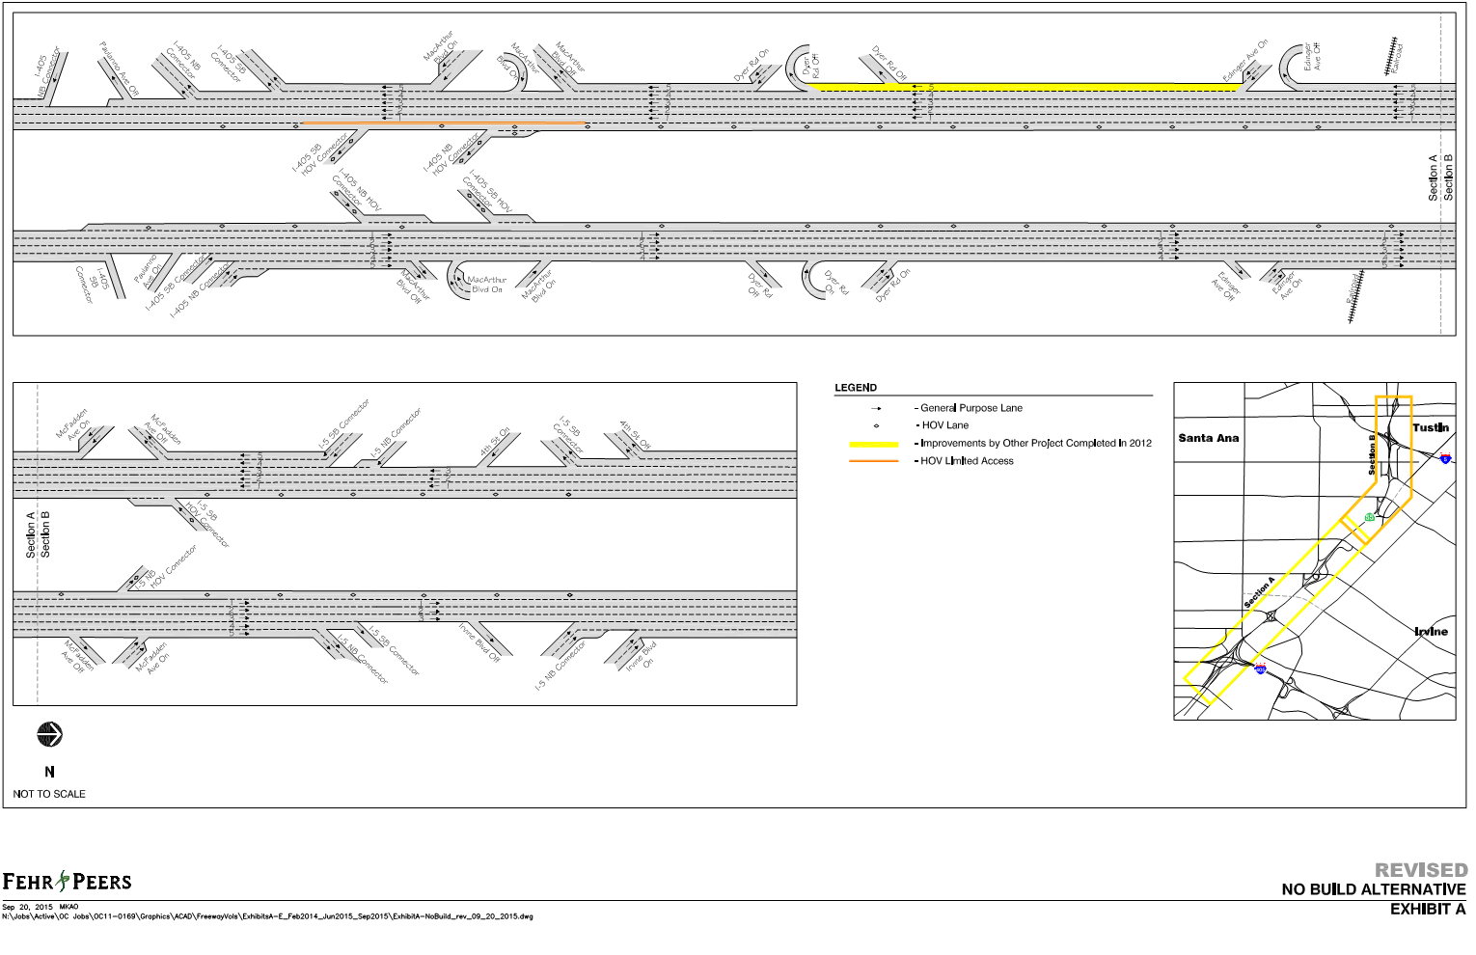
Baseline Schematics

Slide 7
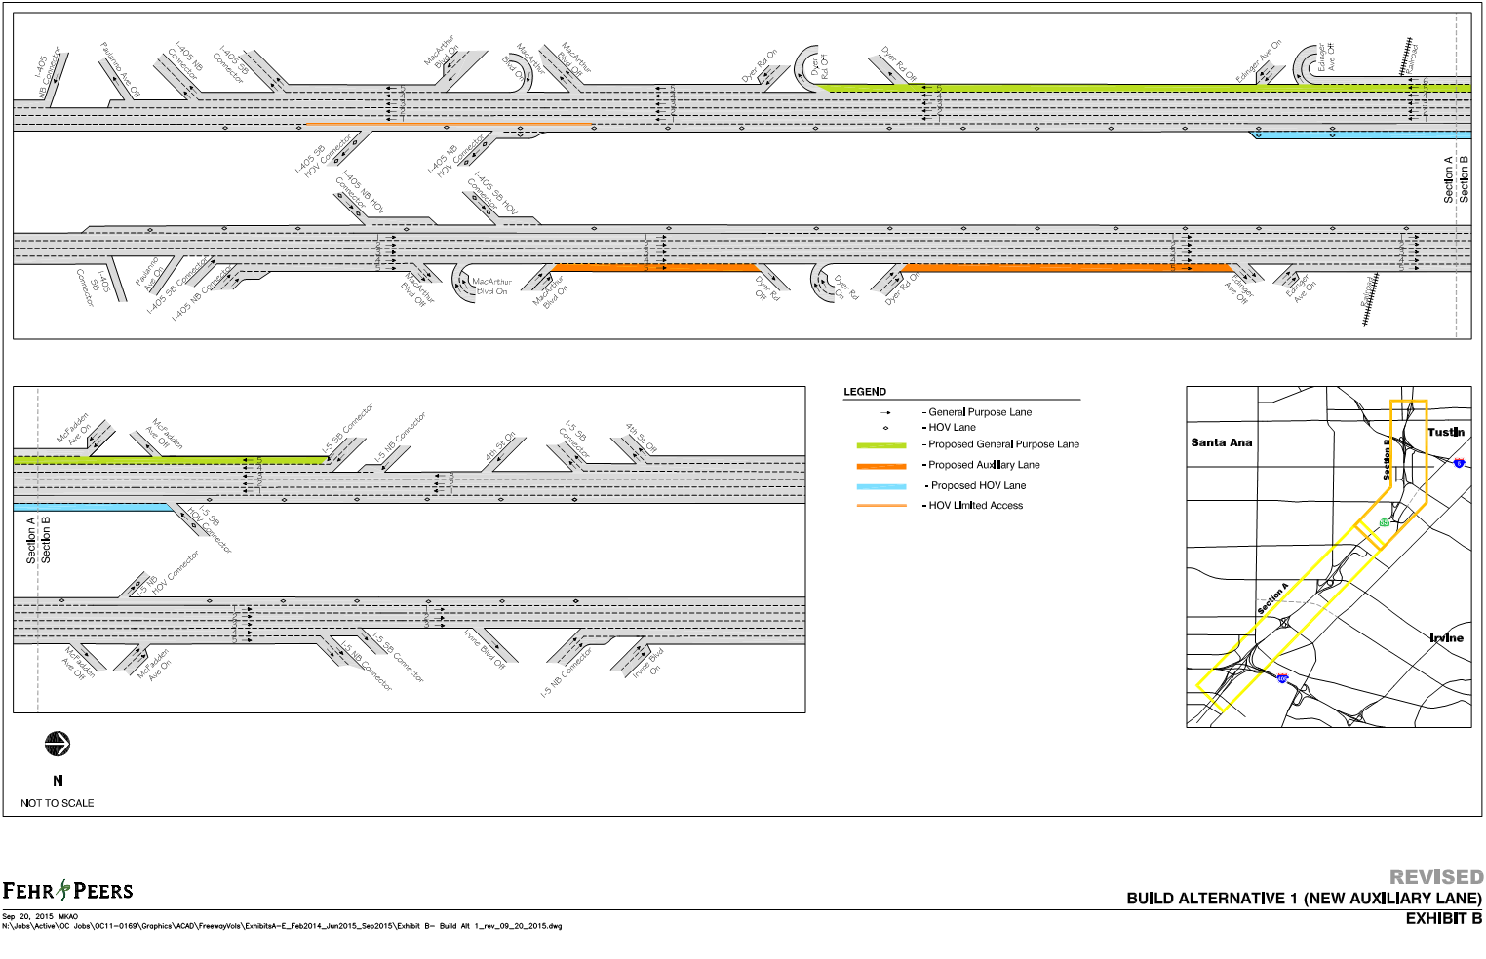
Alternative 1 Schematics

Slide 8
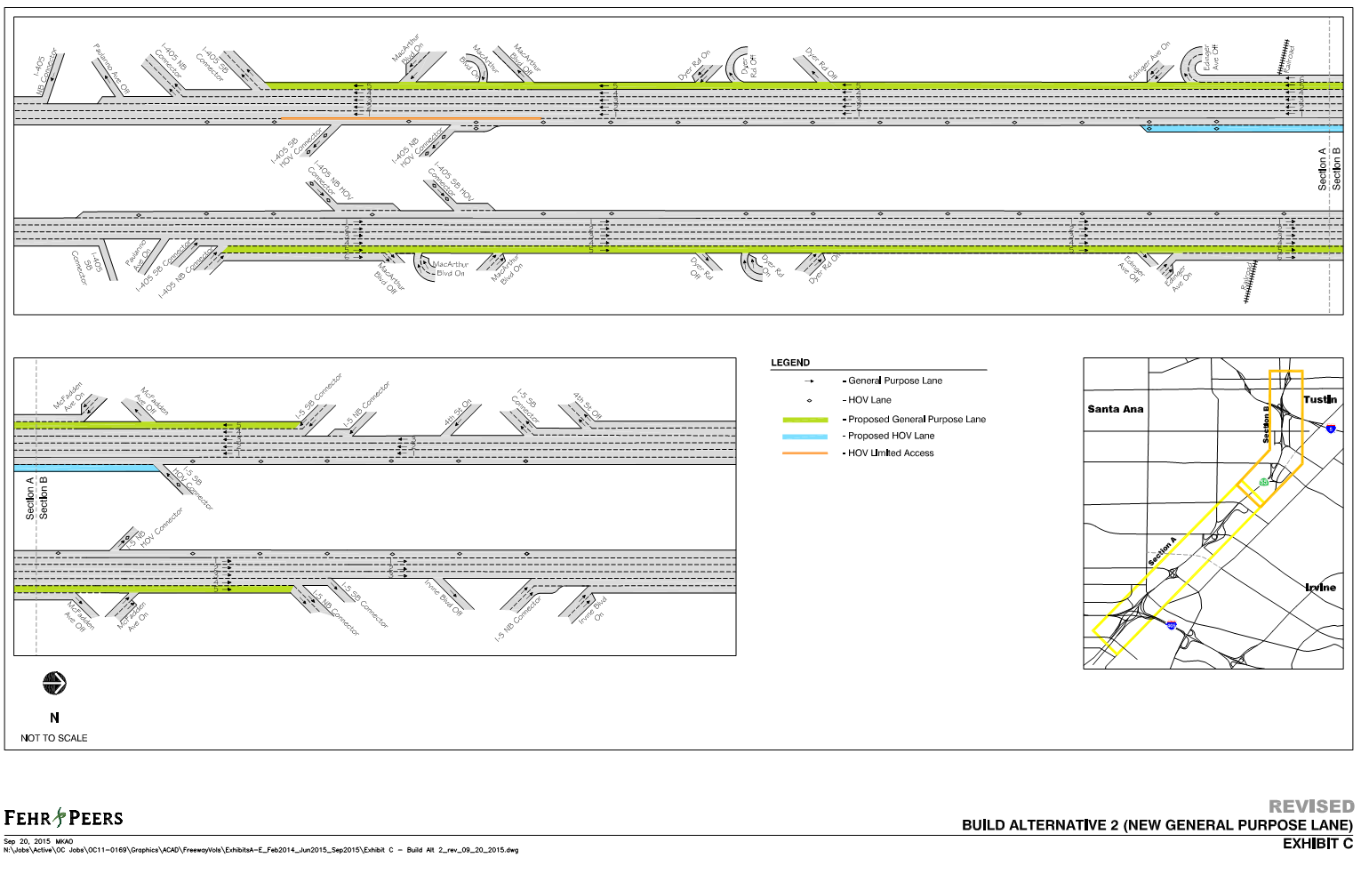
Alternative 2 Schematics

Slide 9
Alternative 3 Schematics

Slide 10
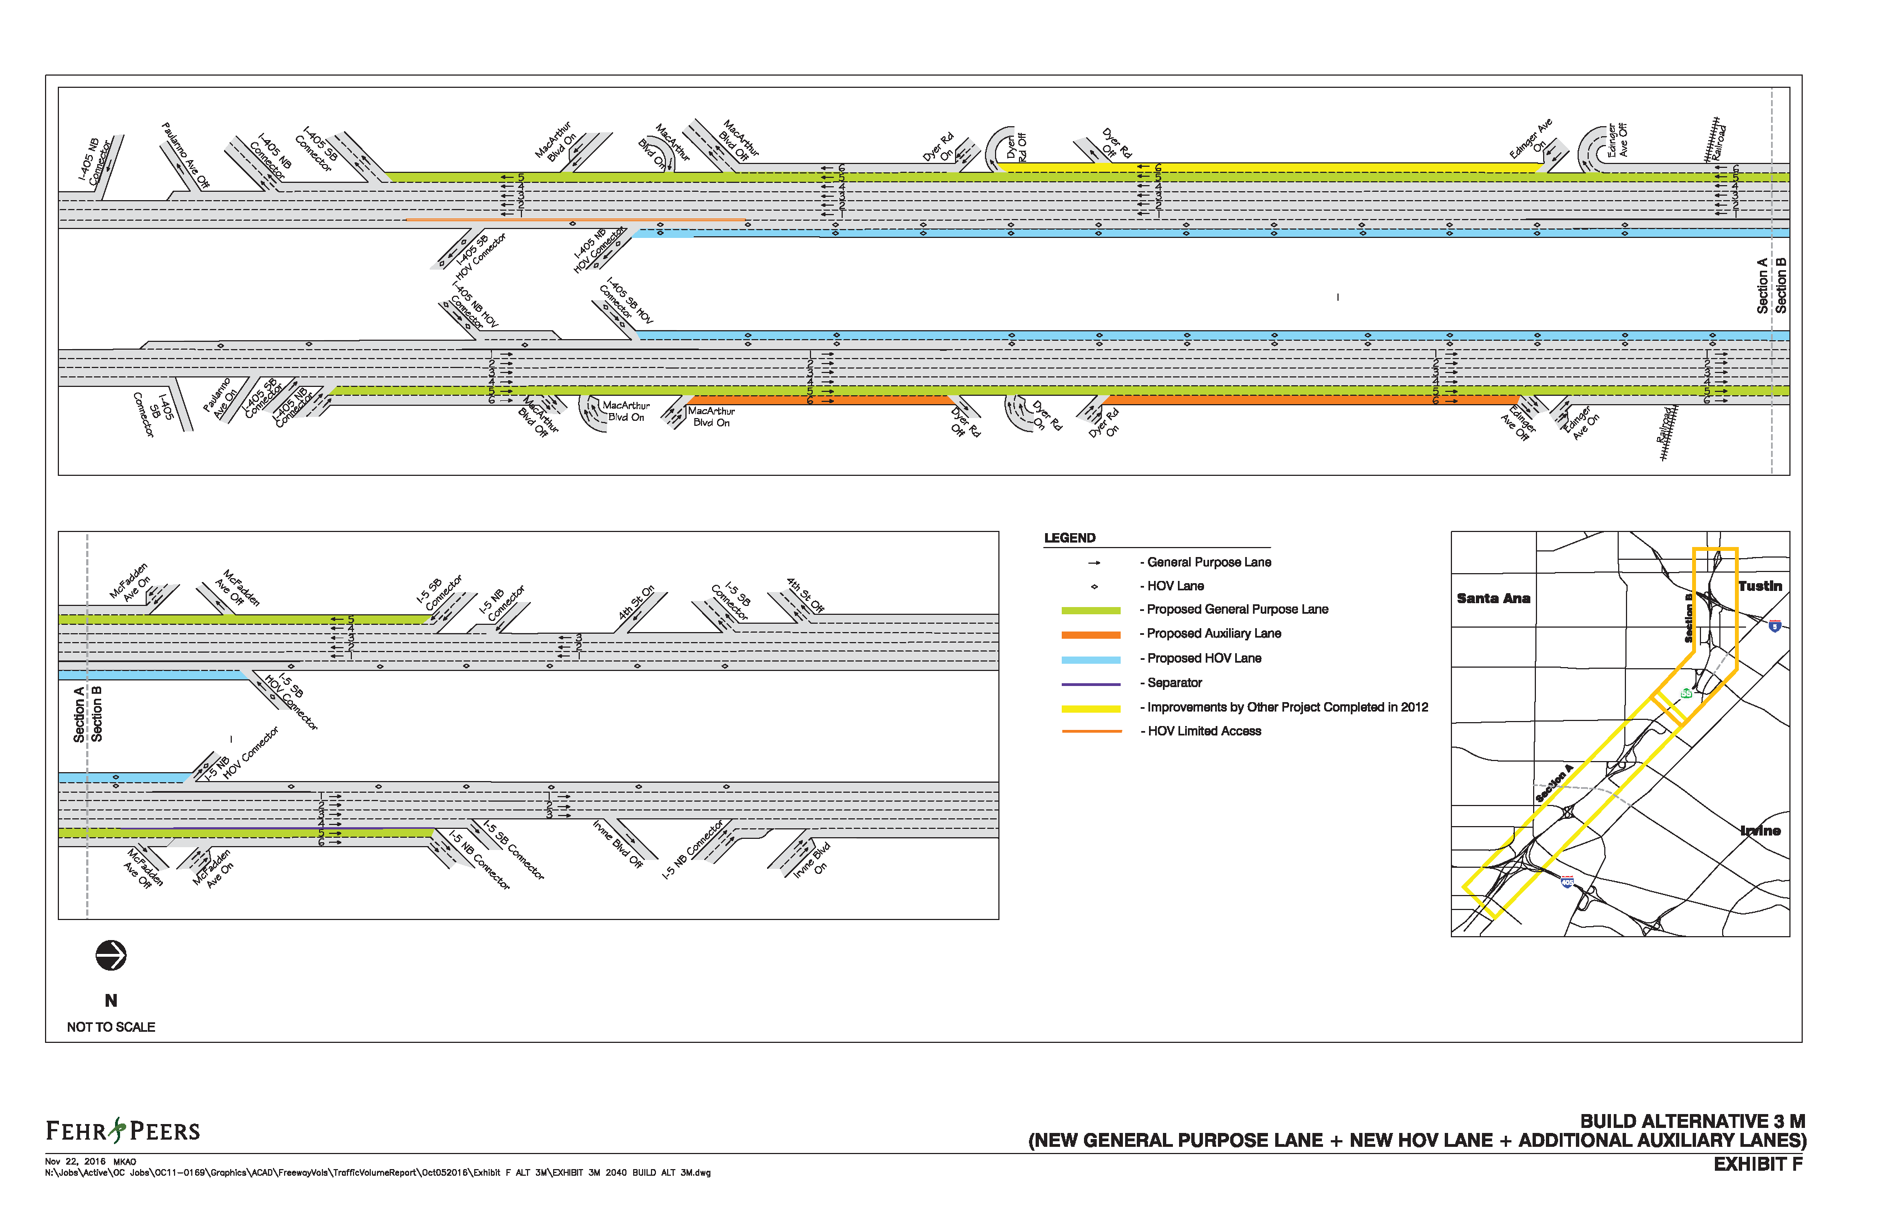
Alternative 3 Mod. Schematics

Slide 11
Alternative 4 Schematics

Slide 12
Project Phases & Timeline
Preliminary Engineering and Environmental Technical Studies | Early 2017
Draft Environmental Document (Recirculation for comments on Alternative 3 Modified) | Mid-2017
Environmental Clearance and Approval | Late 2017
Final Design | Early 2018 to late 2020
Construction | Mid-2021 to mid-2024

Slide 13
Next Steps
Re-circulate draft ED and PR for public comments on Alt 3 Modified
Spring 2017
Select Preferred Alternative
Mid-2017
Finalize Environmental Document
September 2017
Begin Design Phase
December 2017

Slide 14
Contact Information
Chris Boucly
OCTA Public Outreach
714-560-5326
cboucly@octa.net
Jessica Lopez
OCTA Public Outreach
714-560-5766
jlopez@octa.net
www.octa.net/SR55

